Slide 1
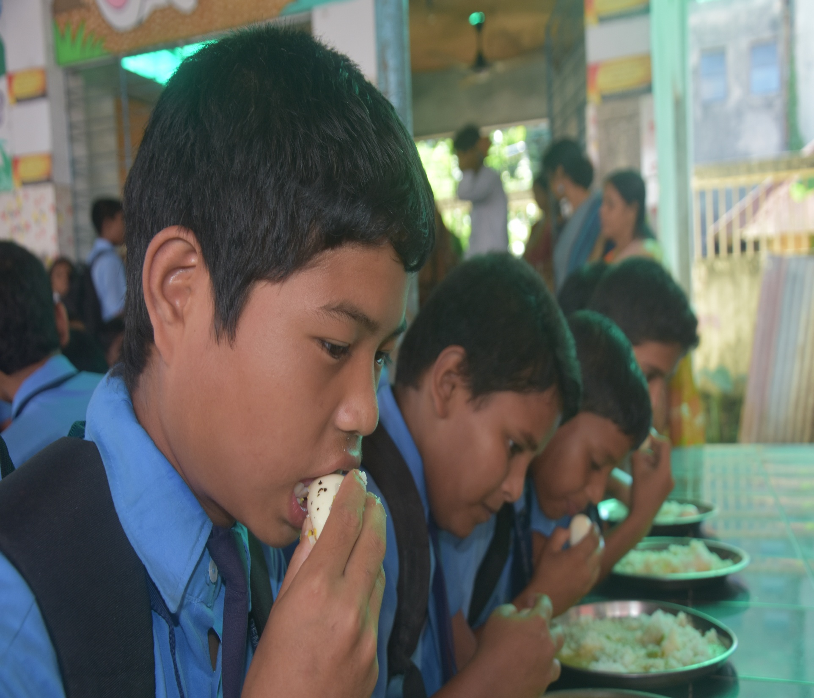
Mid-Day-Meal SCHEME
In Tripura
Meeting of the Programme Approval Board : 2018-19
Of MDMS
Date – 23.05.2018

Slide 2
Brief introduction of Tripura

Slide 3
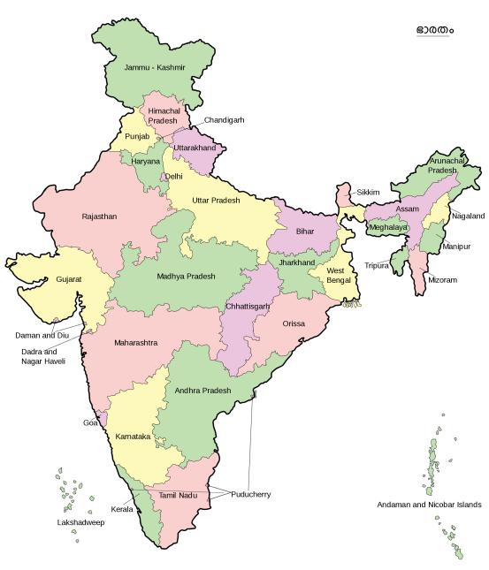
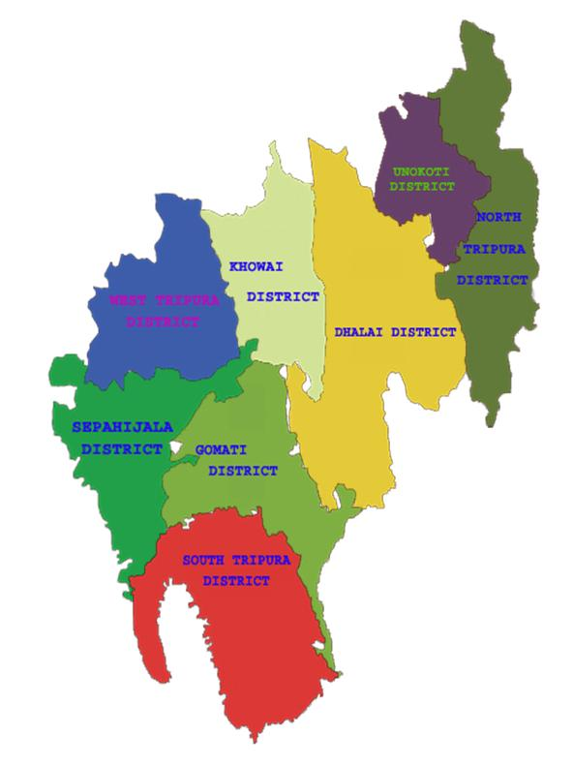
INDIA
TRIPURA

Slide 4
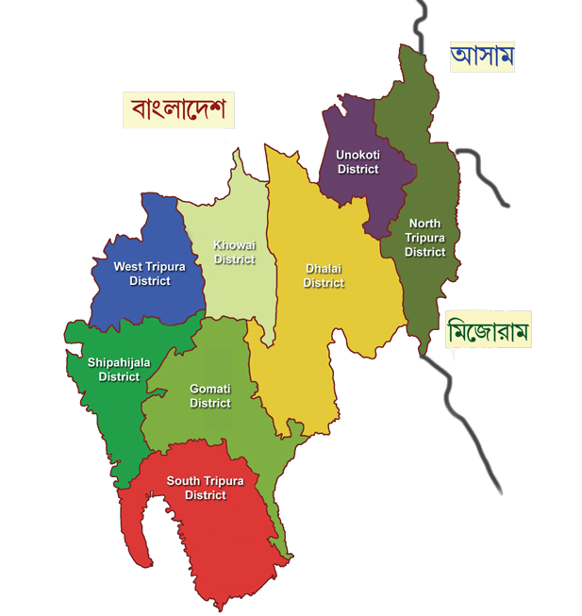
Geographical Location : Tripura is one of the states of 8 North-Eastern states and surrounded by Bangladesh on its three sides.
Total Area : 10,491.69 Sq. Km
No. of Districts : 08
Sub-Divison : 23
No. of Blocks : 58
Population : 36,71,032
Density : 350 / Sq. Km
Sex Ratio : 1000:961
Average Literacy rate : 96.82%

Slide 5
Coverage

Slide 6
Category of Educational Institutions
Stage: Primary (I –V)
Independent Primary Schools (classes I – V)
Primary Sections attached to SB Schools (I-V of SB Schools)
Primary Sections attached to High Schools (I-V of High School)
Primary Sections attached to H.S. Schools (I-V of H.S School)
Stage: Upper Primary (VI-VIII)
Upper Primary Sections Senior Basic Schools (VI-VIII)
Upper Primary Sections attached to High Schools(VI-VIII)
Upper Primary Sections attached to H.S. Schools.(VI-VIII)
100% coverage of all Govt. , Govt. aided schools and Madrassas.

Slide 7
Present Implementation Status

Slide 8
1. Details of School Units
Stage | Govt. | Govt. Aided | Madrassa | Total
Primary | 4262 | 34 | 175 | 4471
Upp. Primary | 2054 | 32 | 11 | 2097
Total | 6316 | 66 | 186 | 6568
*Source MDM-MIS

Slide 9
2. Total Enrolment Vs Availed (01.04.2017 to 31.03.2018)
Stage | No. of Institutions | Total Enrollment | PAB: 2017-18 Approved Enrollment | Average no. of children Availed MDM in 2017-18 | Percentage of children availed MDM Against Total Enrollment
Primary | 4471 | 2,88,140 | 2,35,810 | 2,23,199 | 77.46%
Upp. Primary | 2097 | 1,77,385 | 1,30,385 | 1,26,625 | 71.38%
Total | 6568 | 4,65,525 | 3,66,195 | 3,49,824
*Source MDM-MIS

Slide 10
3. Average Attendance of Children:
The average attendance rate of children in the schools is gradually increasing. A comparison regarding average attendance rate is given below:
Stage | Average Attendance
 | 2014-15 | 2015-16 | 2016-17 | 2017-18
Primary | 69.19% | 77.05% | 77.13% | 77.46%
Upper Primary | 63.75% | 70.14% | 68.48% | 71.38%
*Source MDM-MIS

Slide 11
Year Wise Increasing Trend of Average Attendance Rate :

Slide 12
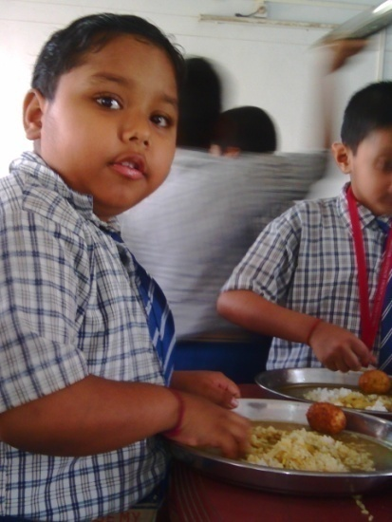
4. Menu & Cost Norms
Weekly Uniform Menu w.e.f. 13th June 2011.
Monday : Khichudi
Tuesday : Rice and Egg curry
Wednesday : Rice & Veg. curry
Thursday : Rice and Egg curry
Friday : Rice & Veg. curry
Saturday : (Payesh /Khichudi /Rice&Veg.)
Cost Norms w.e.f. 1st July 2016:
A. Primary
Total cost norms: Rs.4.22 per child per day.
Govt. of India’s assistance : Rs. 3.72 & State share:Rs.0.50.
Rice 100 gms.
B. Upper Primary
Total cost norms : Rs. 6.18 per child per day.
Govt. of India’s assistance : Rs. 5.56 & State share: Rs. 0.62.
Rice 150 gms.

Slide 13
Reasons for Uniform common Menu for MDM
Equal and uniform nutritional benefit for all students throughout the state.
Similar Food habits.
Better monitoring and administrative effectiveness.
Quality & quantity of MDM can be checked as per specific fixed menu.
Incorporate locally available vegetables.

Slide 14
5. Cook-cum-Helpers:
At present, 11,019 nos. Cook-cum-Helpers engaged under Mid-Day-Meal Scheme at different school units. Cook-cum-Helpers are getting Rs.1,500/- per month (Central Contribution : Rs.900/- & State Contribution Rs.600/-) as honorarium.
6. Kitchen Shed:
Kitchen Sheds have been constructed in all eligible school units as per guidelines of MHRD.
7. Kitchen Devices:
All school units have been facilitated with kitchen devices.
8. MDM-MIS:
100% data entry in MDM-MIS has been completed up-to March, 2018.

Slide 15
Fund & Food grains Status

Slide 16
1. Fund Receipt & Expenditure up to 31st March, 2018: (In lakhs)
Component | Fund received |  | Expenditure incurred / Allotted to Implementing level |  | Fund not allotted |  | Percentage of utilization of funds
 | CSS | State | CSS | State | CSS | State
Cost of Food grains | 296.26 | 0.00 | 296.26 | 0.00 | 0.00 | 0.00 | 100%
TC/DC | 186.64 | 0.00 | 186.64 | 0.00 | 0.00 | 0.00 | 100%
Cooking cost | 3684.95 | 456.67 | 3552.62 | 440.26 | 132.33 | 16.41 | 96%
Honorarium to Cook cum helper | 992.52 | 495.95 | 991.71 | 495.86 | 0.81 | 0.09 | 100%
MME | 92.89 | 0.00 | 92.89 | 0.00 | 0.00 | 0.00 | 100%
Kitchen device | 44.05 | 0.00 | 44.05 | 0.00 | 0.00 | 0.00 | 100%
Kitchen shed | 0.00 | 0.00 | 0.00 | 0.00 | 0.00 | 0.00 | 0
Total | 5297.31 | 952.62 | 5164.17 | 936.12 | 133.14 | 16.50 | 98%

Slide 17
2. Food grains Allotted to implementing level (up to 31st March, 2018):
Opening balance | Received from FCI (in MT) | Total | Utilization of food grains | Un-utilized food grains (in MT)
46.75 | 9875.16 | 9921.91 | 9567 (96%) | 356.13

Slide 18
Best Practices

Slide 19
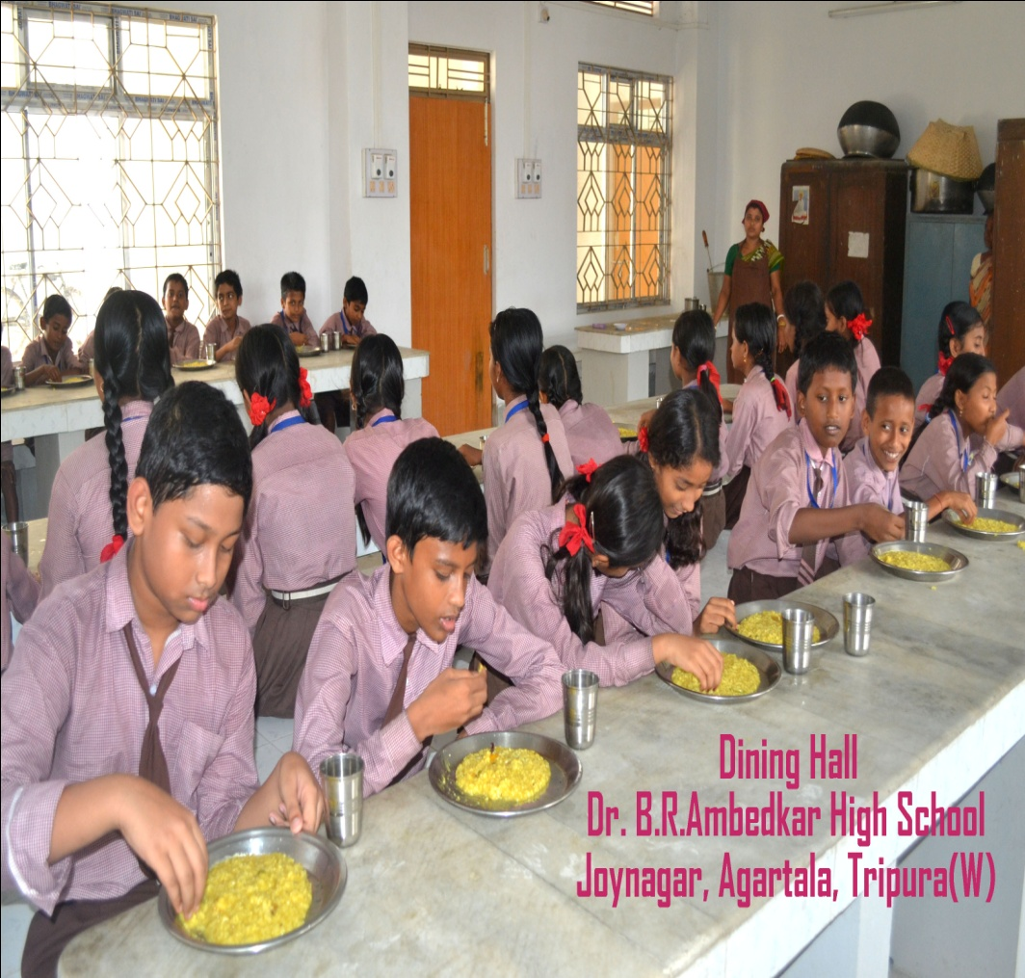
1.Provision of Dining hall:
Dining halls are being constructed with seating arrangement for taking the mid day meal in the school premises. At present, 250 nos. dining halls have been constructed using state’s own resources and more 16 nos. dining halls are in progress under MGNREGA.

Slide 20
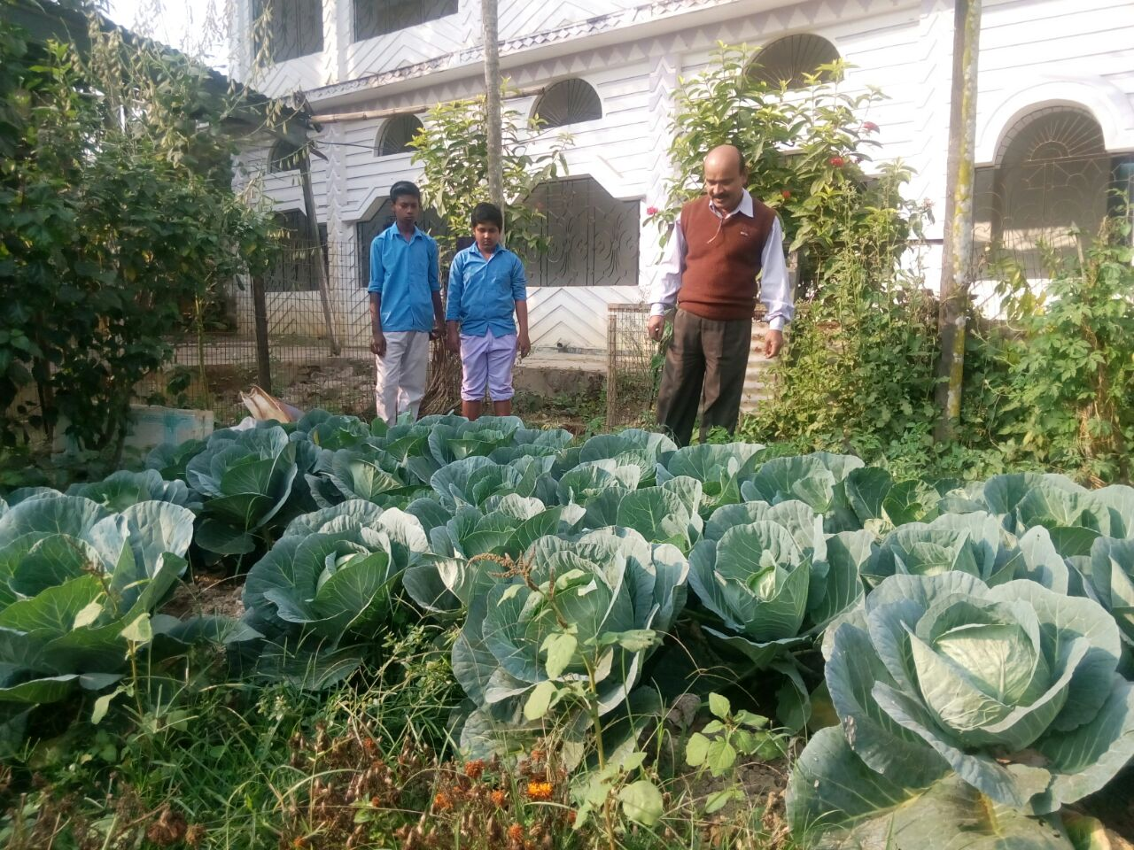
Kitchen gardens have been raised in 471 schools with the objective of giving the children more nutritious & pesticide free food by using the vegetables like, cabbage, potato, tomato, brinjal, radish etc. grown in the kitchen gardens. More 200 schools are being taken initiative for raising kitchen Gardens by dovetailing fund from MGNREGA and Horticulture Department, Govt. of Tripura.
K.B Institutions
Gomati District

Slide 21
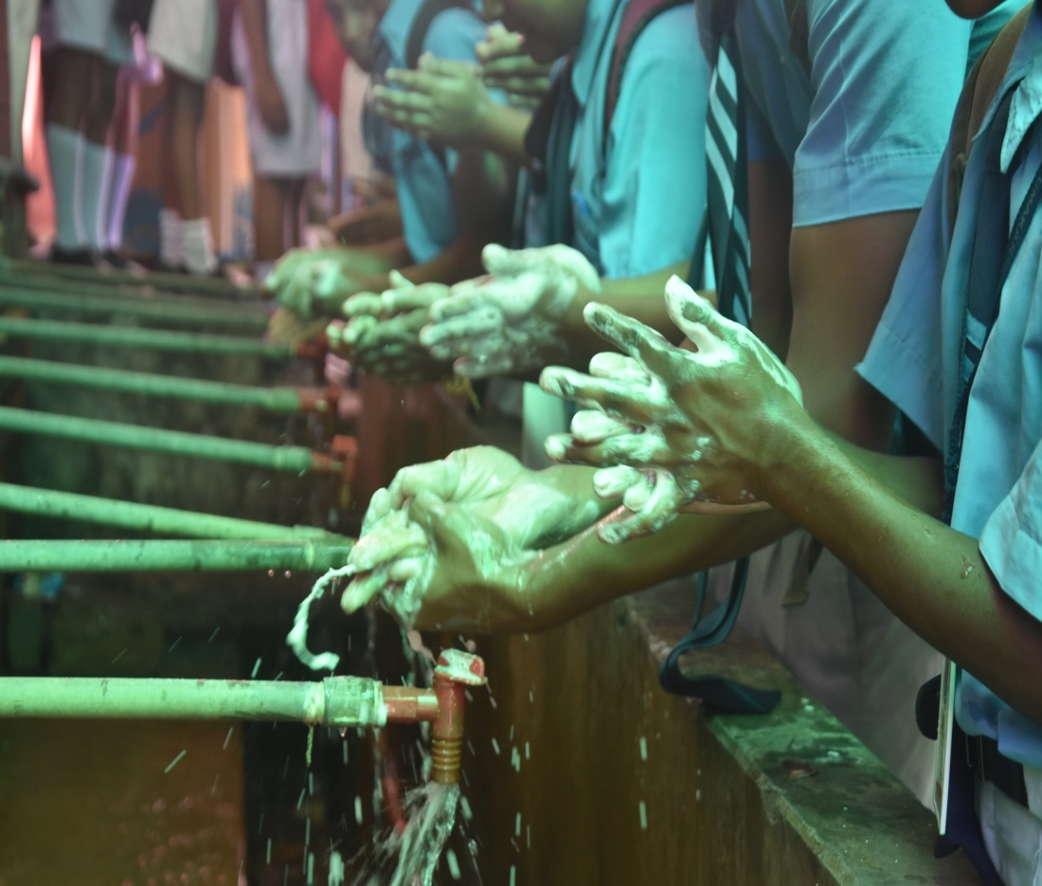
Hand wash activity has been implemented in all school units. The Department has introduced group hand washing system in 1313 nos. schools.
Umakanta Academy
West Tripura District

Slide 22
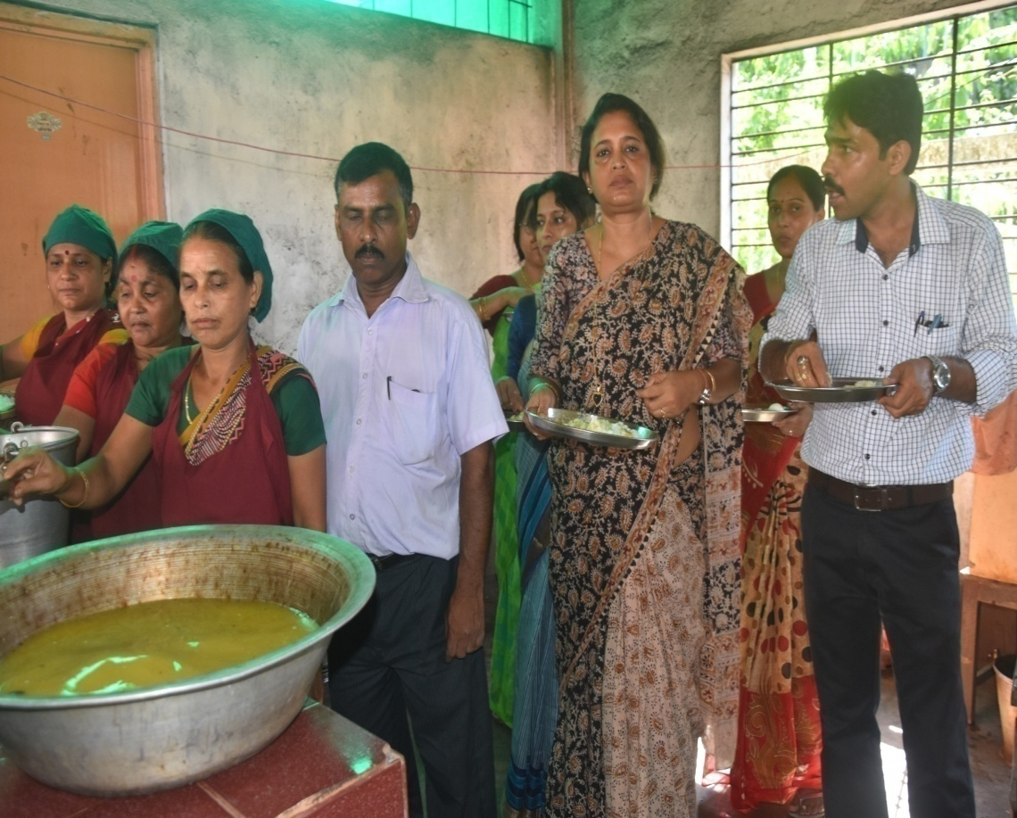
4. Practice of food tasting:
The practice of tasting of cooked food under MDM Programme are being implemented in all school units. Under the practice of tasting of cooked food every day cooked food (mid day meal) must be tasted by the assigned teacher first, secondly by one of the cook-cum-helpers and lastly by at least one mother / parent and they also write their comments in the specific food Tasting Register kept in every school before serving the Mid-Day-Meal to the students.

Slide 23
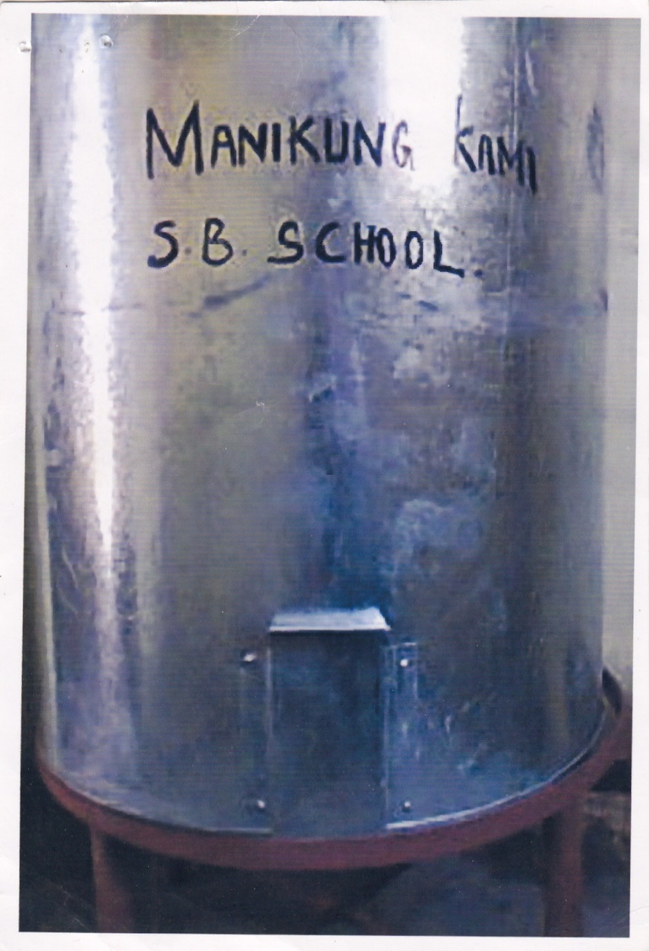
Safe storage bins scientifically designed with FIFO (First In First Out) system have been provided in all school units for storing the food grains in schools.

Slide 24
Achievements

Slide 25
1. 100% Coverage of School & children.
100% of enrolled children in all Govt. & Govt. aided schools, Madrassa institution are being covered under Mid-Day-Meal Scheme.
2. Increase of average attendance rate:
The average attendance rate of children in the schools has been gradually increasing.
Stage | Average Attendance
 | 2014-15 | 2015-16 | 2016-17 | 2017-18
Primary | 69.19% | 77.05% | 77.13% | 77.46%
Upper Primary | 63.75% | 70.14% | 68.48% | 71.38%

Slide 26
3. Drop out rate reduced from 27% in 2005-06 to 1.09% in 2017-18 at Elementary Stage.
4. Mid-day-Meal Scheme is being ensured the proper nutrition of school children. They are being provided with high Calorie of nutrients like Rice, Pulse (dal), Soya Protein and Eggs.
5.Implementation of MDM Programme in NRSTCs (Non Residential Special Training Centre):
During the year 2014-15, w.e.f July 1st 2014 MDM Programme has been started in 16 nos. NRSTCs for Reang Migrant Children.
Total 3128 children are being benefitted by the programme.

Slide 27
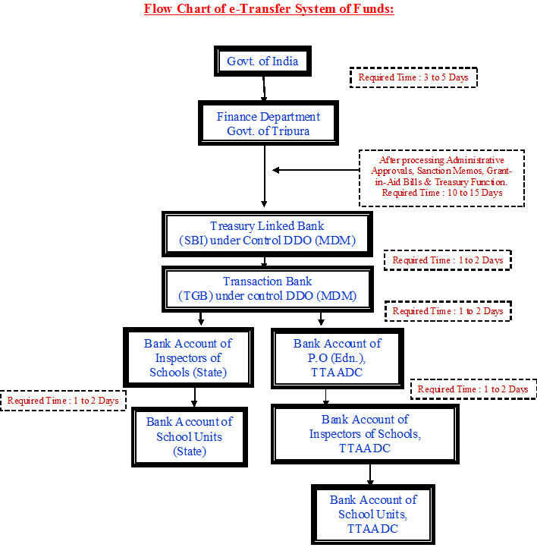
6. Introduction of E-Transfer System:
To overcome the unnecessary delay in fund transfer from State level to implementing level, e-transfer system of fund has been introduced. Under this system funds are being transferred electronically as per following steps :

Slide 28
7. Regular Payment of honorarium of cook-cum-helper :
Total 11019 cook-cum-helpers are engaged under Mid-Day-Meal Programme out of total 11028 approved cook-cum-helpers. The honorarium for the cook cum helpers has been released up to March, 2018.
Monthly honorarium (Rs. 1,500/- per month) of cook-cum-helpers engaged under MDM Programme is disbursed through their individual bank account.
8. Training of Cook-cum-Helpers:
Initiative has been taken to provide training to the CCHs under MDMS on Safety & Hygiene in convergence with other departments like Fire Service Deptt., Health & family Welfare Department, Physiology Department of Tripura University etc. 10943 nos. Cook-cum-Helpers have been trained by the Department out of 11019.

Slide 29
9. School Inspection :
Beside the supervision of Steering cum Monitoring Committees activated at State, District, Sub-Division level, Departmental officers right from Dy. Inspector of Schools to the Director are conducting inspections regularly in schools as per fixed monthly inspection target.
Fixed Monthly Inspection Target:
Sl | Officer | Fixed Monthly Inspection Target
1 | Director, Elementary Education & SPD,SSA | 06
2 | ASPD,Joint SPD,SSA Rajya Mission | 08
3 | Director, SCERT | 08
4 | Addl. Director/ Joint Director/ Dy. Director/ SRO/ A.O/ O.S.D and other officers posted to the Directorate of School Education, SCERT and SSA Rajya Mission. | 08
5 | District Education Officer | 10
6 | District Inspector of Schools | 10
7 | Inspector of Schools | 14
8 | Dy. Inspector of Schools | 20

Slide 30
10. Provision of LPG based cooking system in schools:
LPG based cooking system has been introduced in 1711 (26%) school units from state own resources.
11. Social Audit of the Programme:
The Social Audit Unit under Audit Directorate, Govt. of Tripura has been requested to conduct Social Audit of the Scheme. Later on “MOU” has also been signed between the Director, Elementary Education and the Director, Social Audit Unit for conducting Social Audit in 208 schools at West Tripura District and Dhalai District at the cost of Rs. 14,70,000/-. Now, the work of Social Audit is going on.

Slide 31
12. IEC Activities:
To aware the general public and students regarding the basic guidelines of MDM Programme two types of publicity material has been devised by the Department and accordingly these are displayed in all schools.
District wise workshops have been conducted regarding safety, cleanliness & hygiene in schools.
A documentary film has been developed regarding raising of kitchen garden in schools and broadcasted in local channels for generating awareness.
13. Implementation of Automated Monitoring of MDMS:
Automated Monitoring System (AMS) has been rolled out in Tripura for monitoring the scheme more effectively. Presently, 61% schools are reporting on daily basis. The Department has also taken an initiative to monitor the teacher attendance on daily basis through the AMS.

Slide 32
14 . Grievance Redressal Cell:
The department has already put into place the Grievance Redressal Mechanism for better and effective monitoring of the Mid-Day-Meal Scheme in the State. A Toll Free number (1800-345-3667) has also been introduced for Redressal of any sorts of grievances under MDM in Schools.
Period | No. of Complain | Action Taken
1st April, 2017 to 31st March, 2018 | 14 (Press Clipping – 13) (Written – 01) | Enquired and found baseless – 09. Show-Cause notice issued – 01. Dropped with warning - 02 2 nos. cases are under process.

Slide 33
Issues Under MDM Programme
1. Enhancement of cooking cost:
At present cooking cost is providing @ Rs.4.22 (Central contribution 3.72 & State contribution Rs.0.50) for primary stage and Rs.6.18 (Central contribution Rs.5.56 & State contribution Rs.0.62) for upper primary. Considering the present market price it is not sufficient. As per decision of the S-SMC meeting, the cooking cost is proposed Rs.9/-(CSS:Rs.8.10/- & State Share: Rs.0.90/- for primary and Rs.13.18 (CSS: Rs.11.86 & State Share: Rs.1.32/-) for upper primary.
2. Enhancement of honorarium of cook-cum-helpers:
At present the cook-cum-helpers engaged under MDMS are getting Rs.1,500/- per month (Central contribution Rs.900 & State contribution Rs.600). The honorarium may be enhanced to Rs. 3000.00 ( CSS: Rs.2,400 & State Share: Rs.600/-).

Slide 34
3. Management Monitoring Evolution (MME):
The MME fund is being sanctioned on the basis of 1.8% of total recurring fund, where as in SSA the percentage is 6%. Considering the present price index of essential commodities, it is proposed to be Rs.30 Lakhs per District for the small State like Tripura or may be increased at least 3% of total recurring fund.
4. Fund provision for LPG:
In order to maintain the cleanliness & hygiene in schools, LPG is very important in all schools. As there is no fund provision for LPG under MDM Scheme, the State has provided fund in 1711 school units for procurement of LPG connection. Therefore, it is requested to provide fund for procuring LPG connection in remaining 4857 school units @ Rs. 9,000/-.

Slide 35
Proposed Budget for 2018-19

Slide 36
Proposed Annual Budget for the Year 2018-19 (In lakhs)
Sl. No | Component | Primary |  |  | Upper Primary |  |  | Total |  | Total
 |  | CSS | State | Total | CSS | State | Total | CSS | State
Recurring Assistance
1 | Cooking Cost | 4354.30 | 483.81 | 4838.11 | 3661.47 | 407.52 | 4068.99 | 8015.77 | 891.33 | 8907.10
2 | Cost of Food grains | 161.27 | 0.00 | 161.27 | 138.93 | 0.00 | 138.93 | 300.20 | 0.00 | 300.20
3 | Honorarium of CCH | 655.83 | 437.22 | 1093.05 | 336.69 | 224.46 | 561.15 | 992.52 | 661.68 | 1654.20
4 | Tranportation Assistance | 101.60 | 0.00 | 101.60 | 87.52 | 0.00 | 87.52 | 189.12 | 0.00 | 189.12
5 | MME | 94.91 | 0.00 | 94.91 | 76.04 | 0.00 | 76.04 | 170.95 | 0.00 | 170.95
Total Recurring Assistance |  | 5367.91 | 921.03 | 6288.94 | 4300.65 | 631.98 | 4932.63 | 9668.56 | 1553.01 | 11221.57
Non-Recurring Assistance
6 | Kitchen Devices | 66.00 | 0.00 | 66.00 | 33.95 | 0.00 | 33.95 | 99.95 | 0.00 | 99.95
7 | Proposal for fund for LPG connection in 4857 school units @Rs.9,000/- | 334.8 | 0 | 334.8 | 102.33 | 0 | 102.33 | 437.13 | 0 | 437.13
Grand Total |  | 5768.71 | 921.03 | 6689.74 | 4436.93 | 631.98 | 5068.91 | 10205.64 | 1553.01 | 11758.65

Slide 37
Requirement of total fund for 2018-19 (Primary & Upper Primary) Central + State Share
Share | Primary | Upper Primary | Grand Total (in Lakhs)
Central | 5768.71 | 4436.93 | 10205.64
State | 921.03 | 631.98 | 1553.01
Grand Total | 6689.74 | 5068.91 | 11758.65

Slide 38
CSS: Rs.102.05 crore
State Share: Rs.15.53 crore
Total budget: Rs.117.58 crore

Slide 39
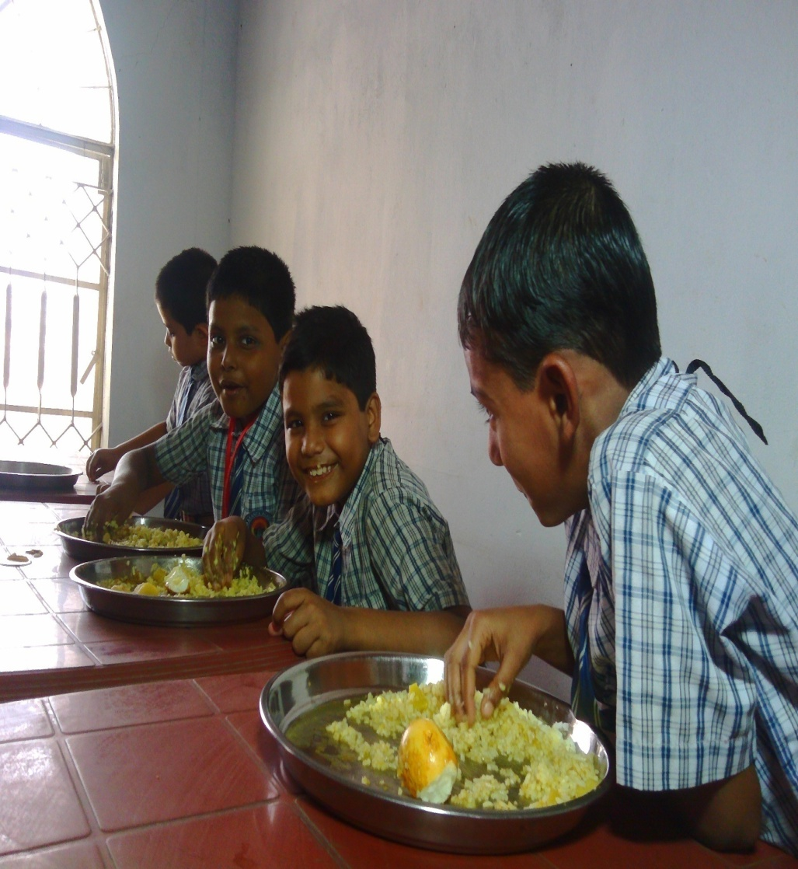
Children Taking Nutritious MDM (Rice & Egg Curry)
Umakanta English Medium School

Slide 40
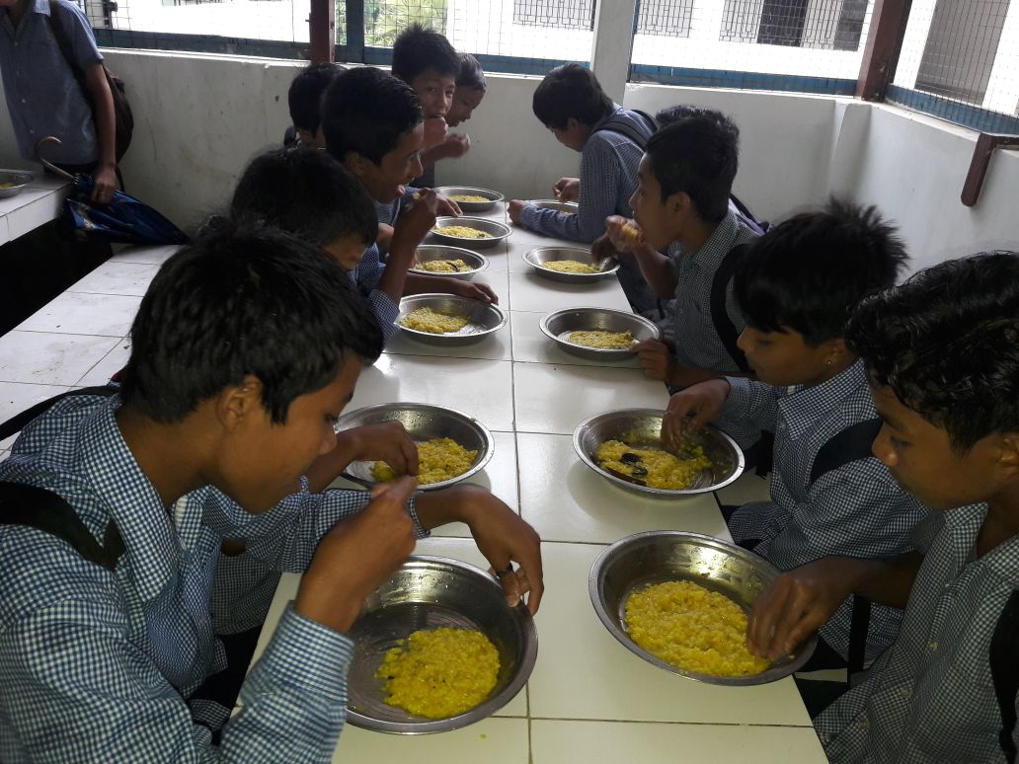
Students are taking MDM
Mohanbhog H.S School
Sepahijala District

Slide 41
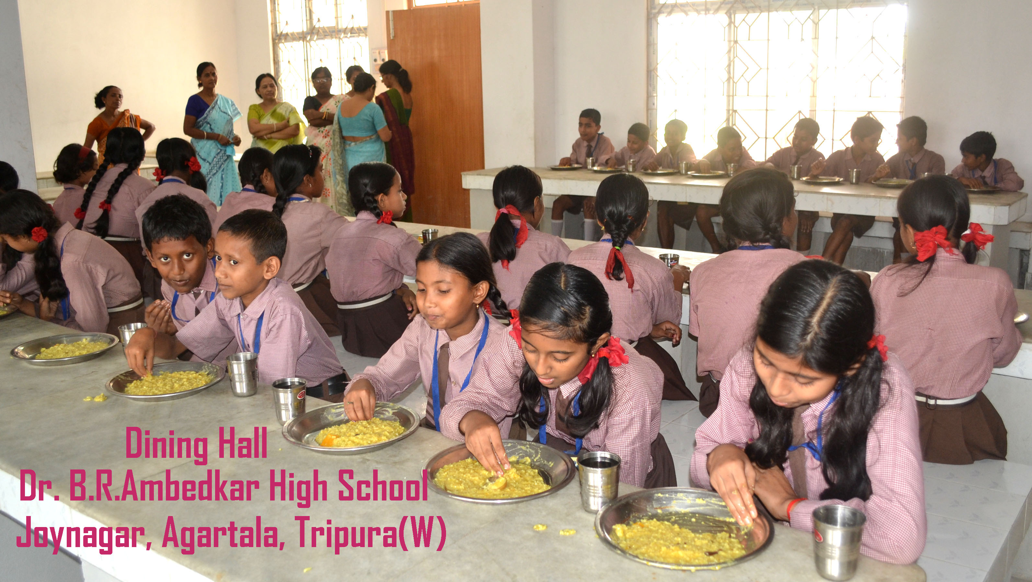
Students are taking MDM
under supervision of SMC Member

Slide 42
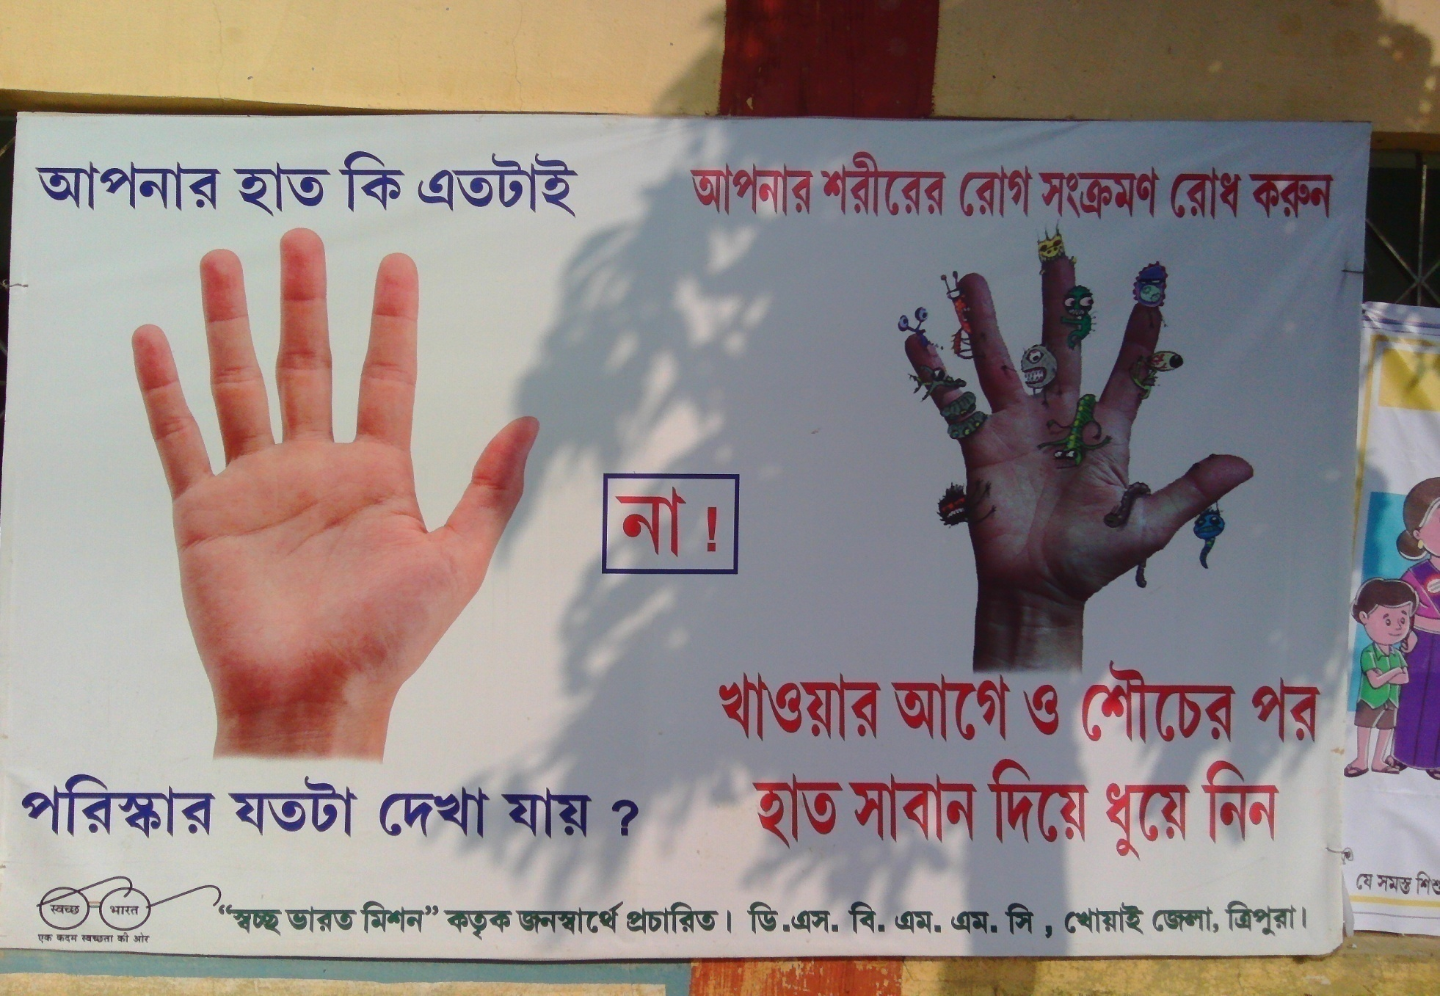
Campaigning for Hand Wash

Slide 43
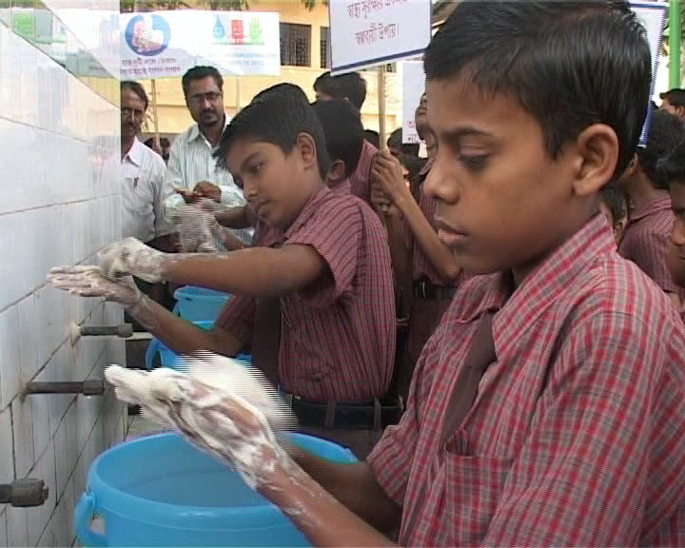
Group Hand Wash
Dr. B.R Ambedkar High School
West Tripura District

Slide 44
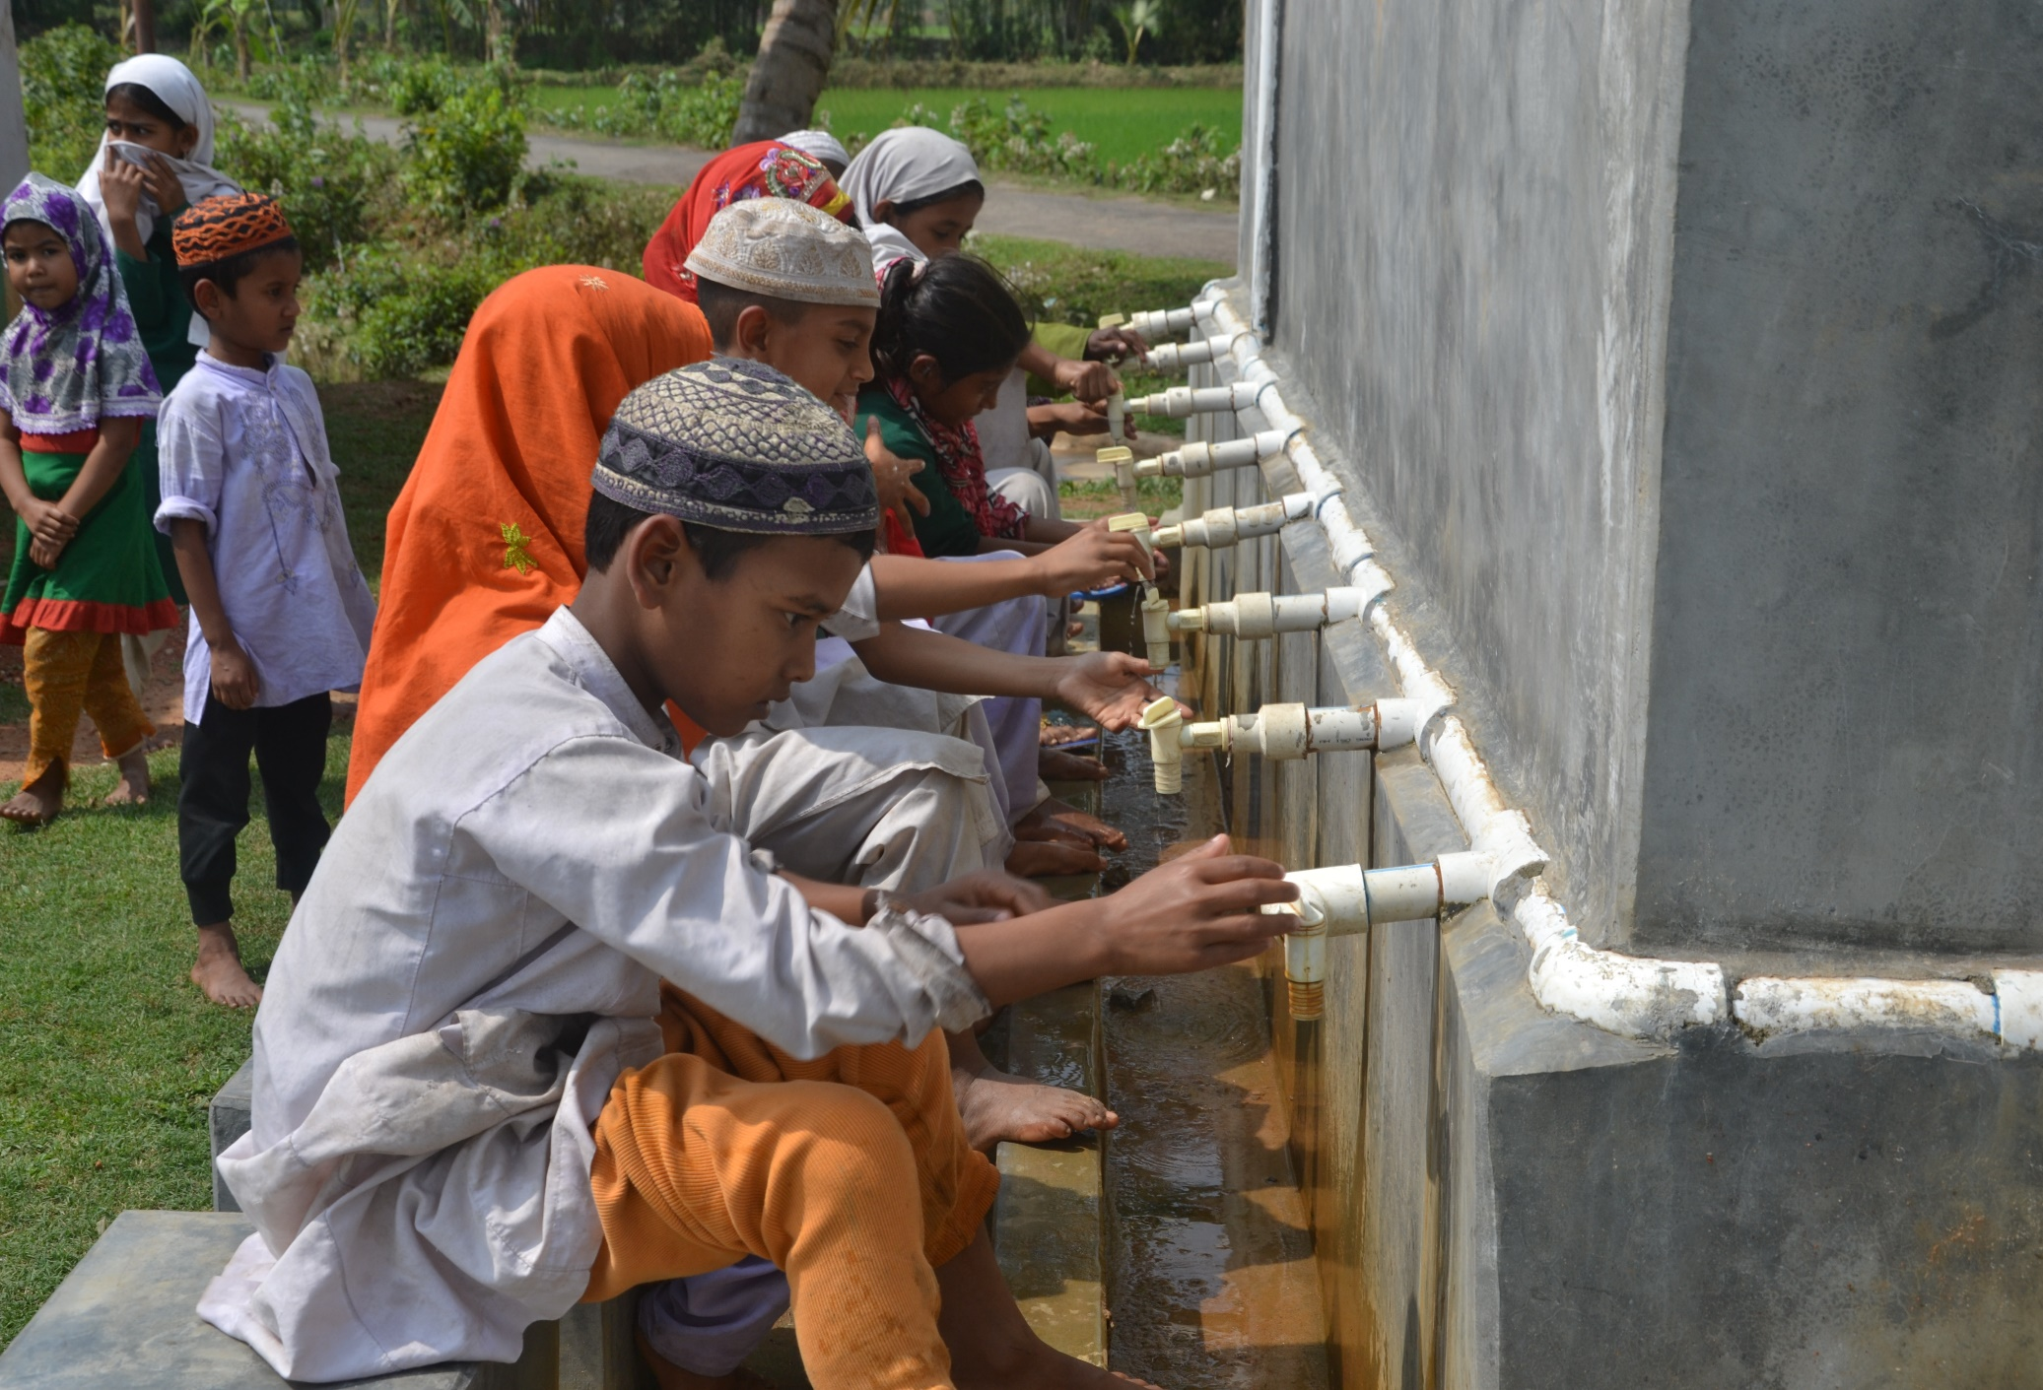
Group Hand Wash
South Ramnagar Jr. Madrassa
West Tripura District

Slide 45
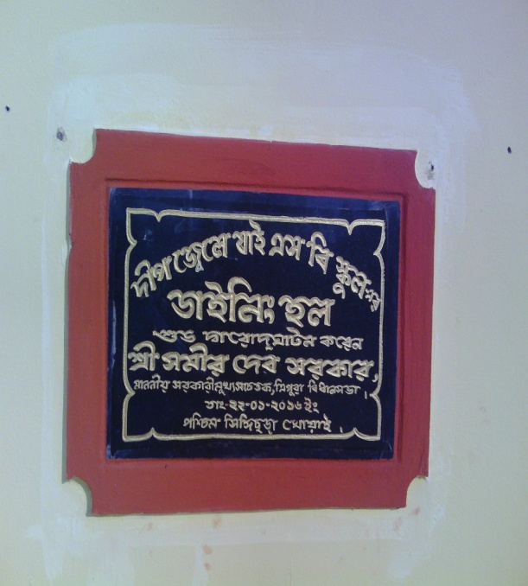

Slide 46
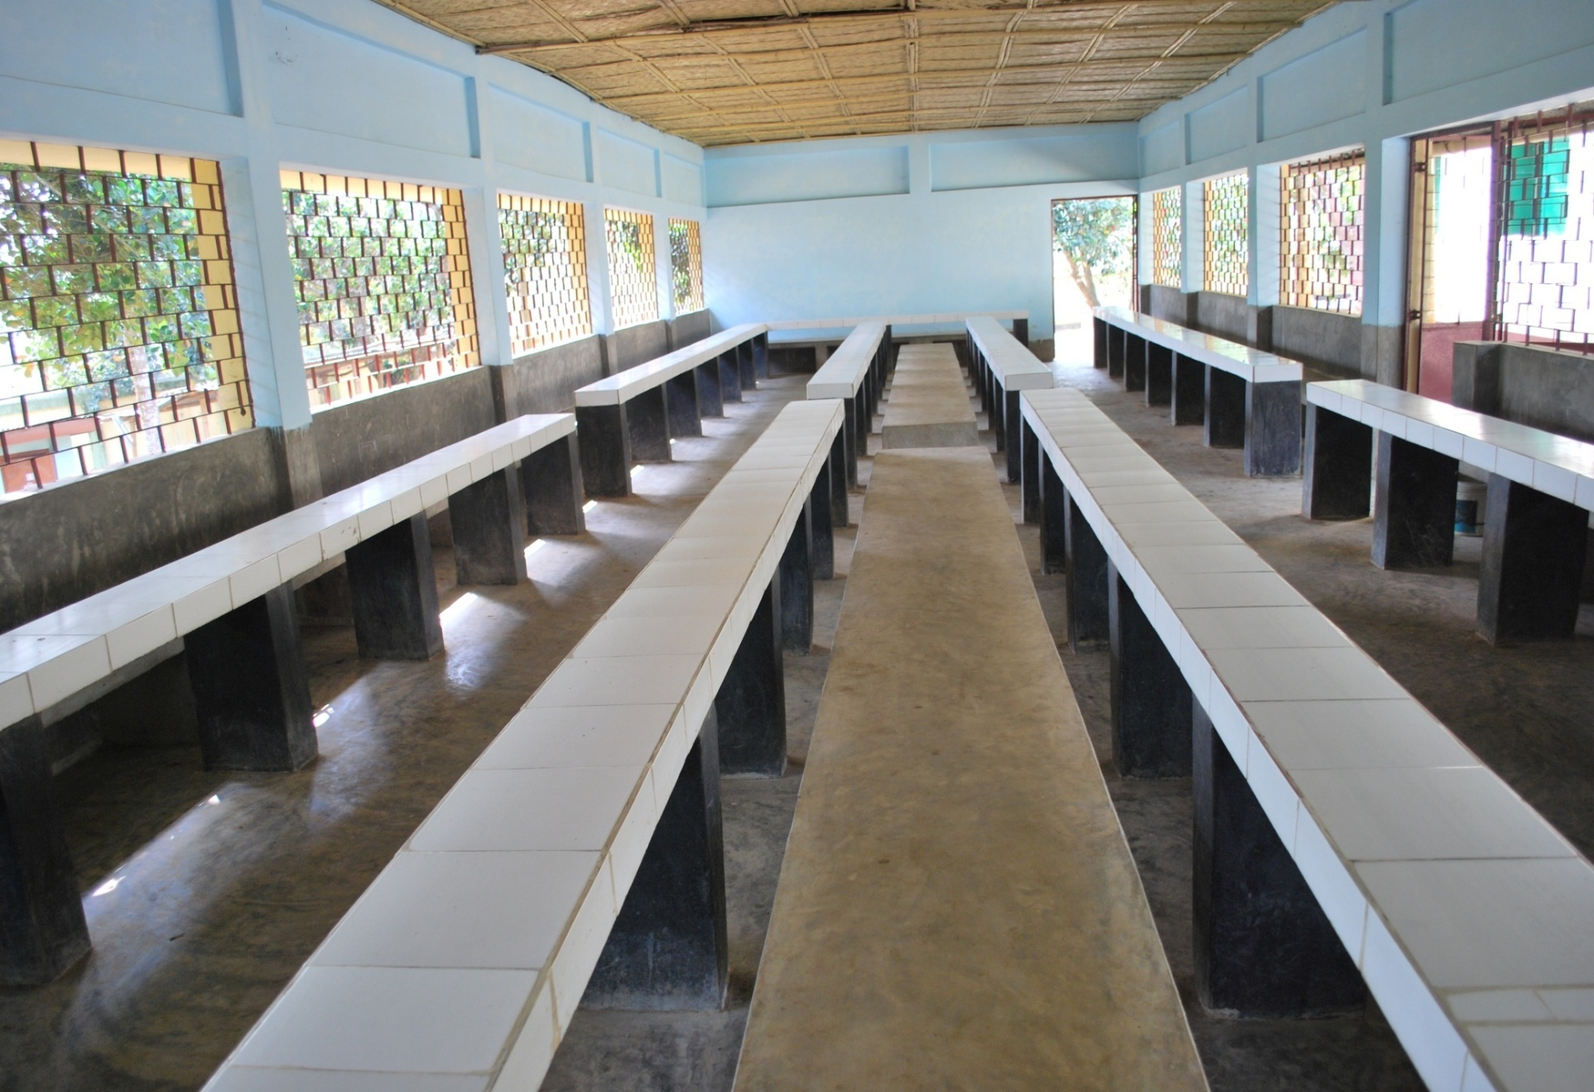
DINING HALL
AMBEDKAR ADARSHA HIGH School
GAKUL NAGAR, TRIPURA(Sepahijala)

Slide 47
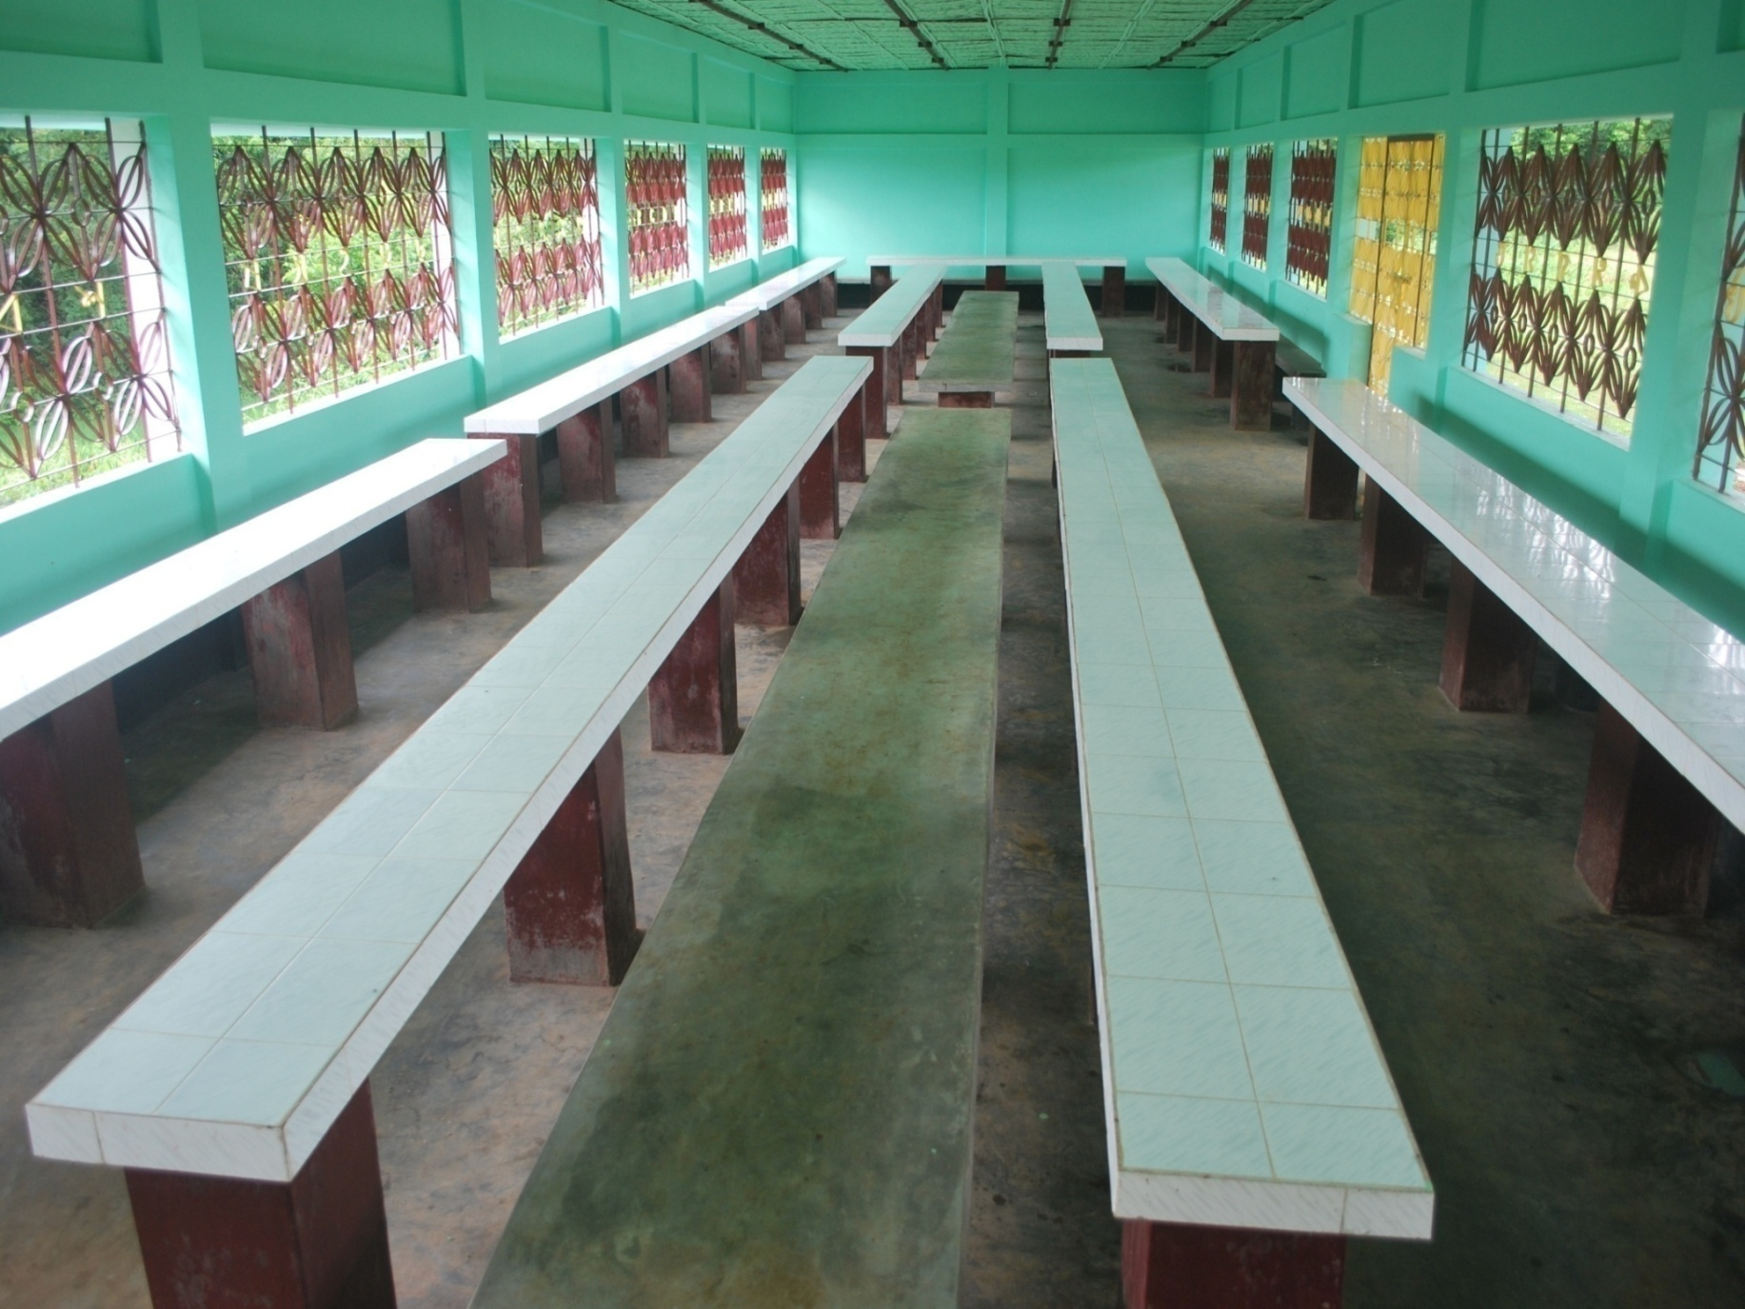
DINING HALL
Narsinghgarh H.S School

Slide 48
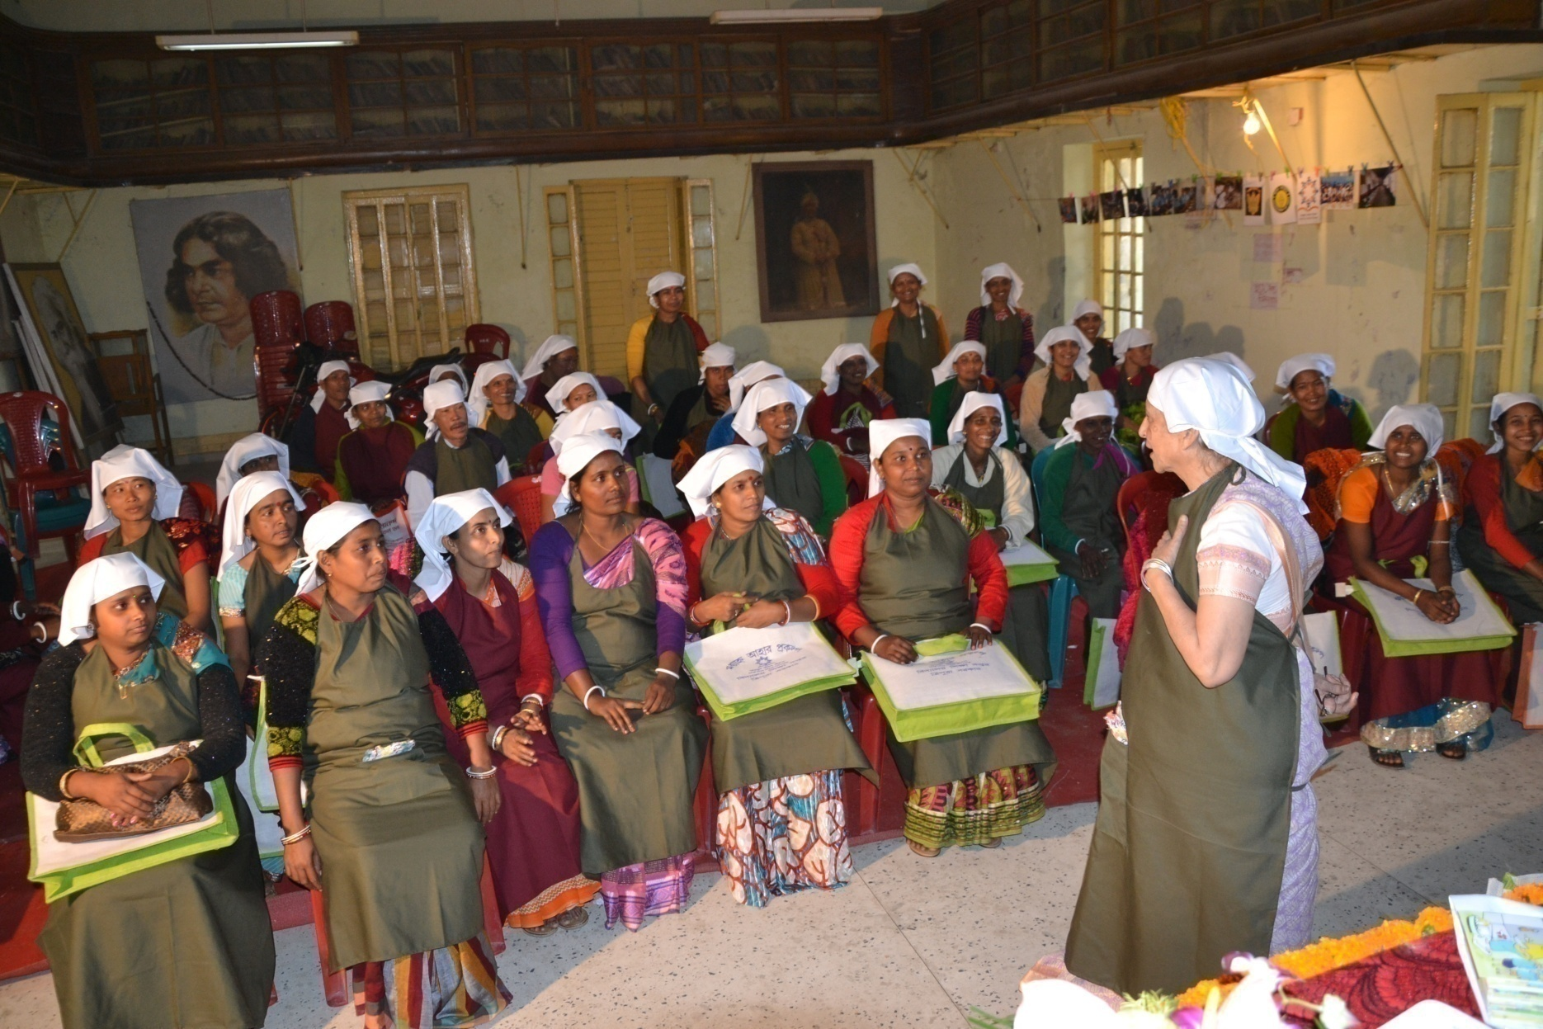
Training Programme of Cook-cum-Helpers

Slide 49
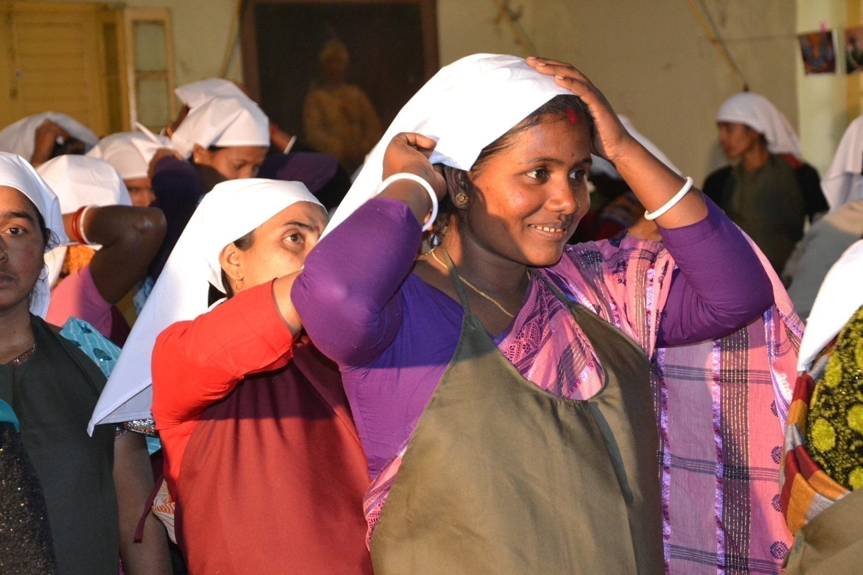
Trained Cook-cum-Helpers

Slide 51
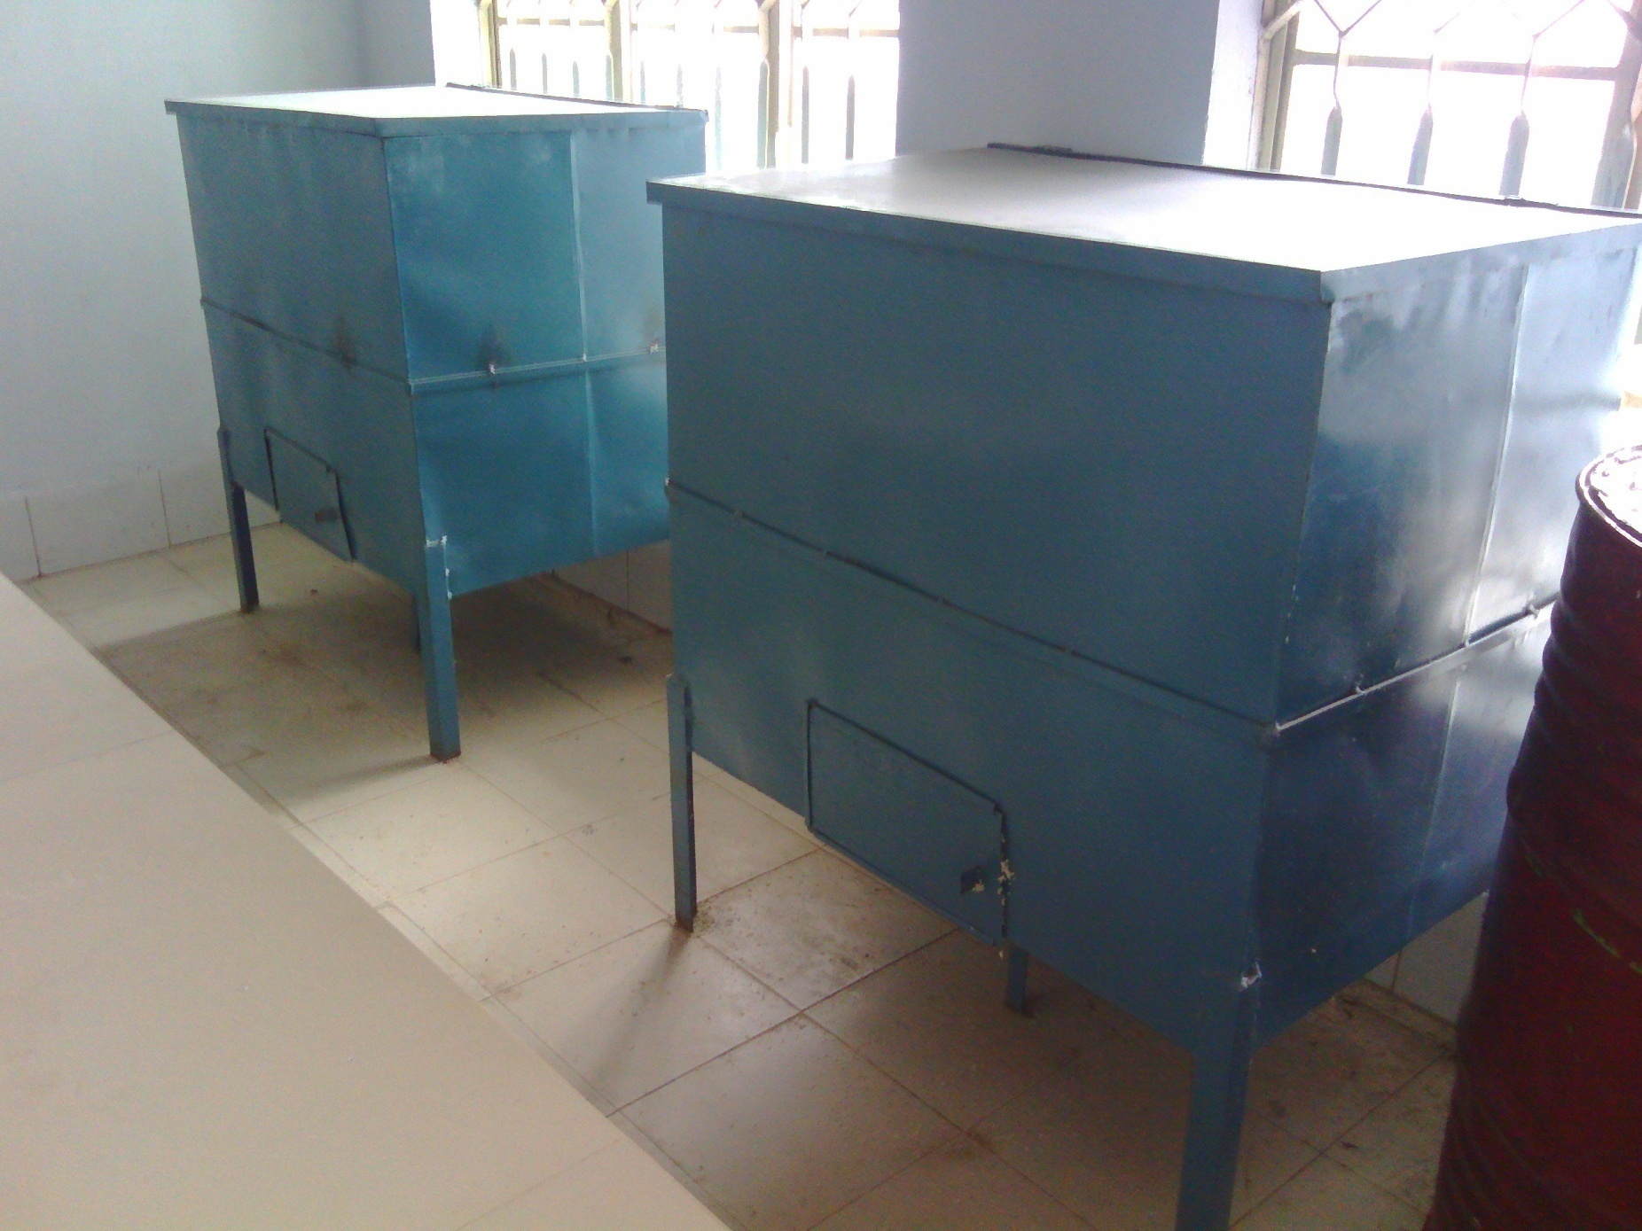
Good Quality Storage Bins
Shishu Bihar H.S school
West Tripura District

Slide 52
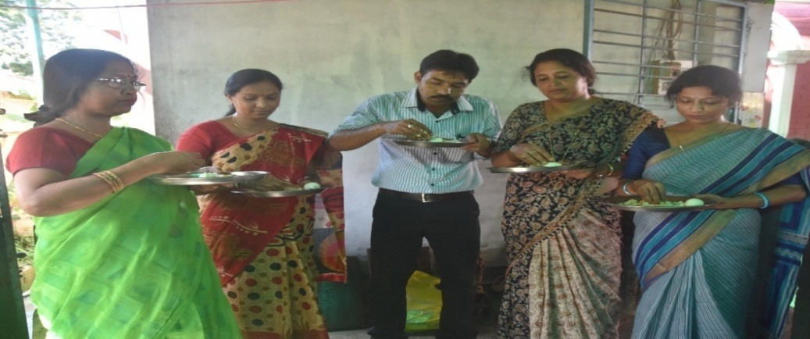
TASTING OF COOKED MEALS BY PARENTS & TEACHERS BEFORE SERVING TO THE CHILDREN
Umakanta Academy
West Tripura District

Slide 53
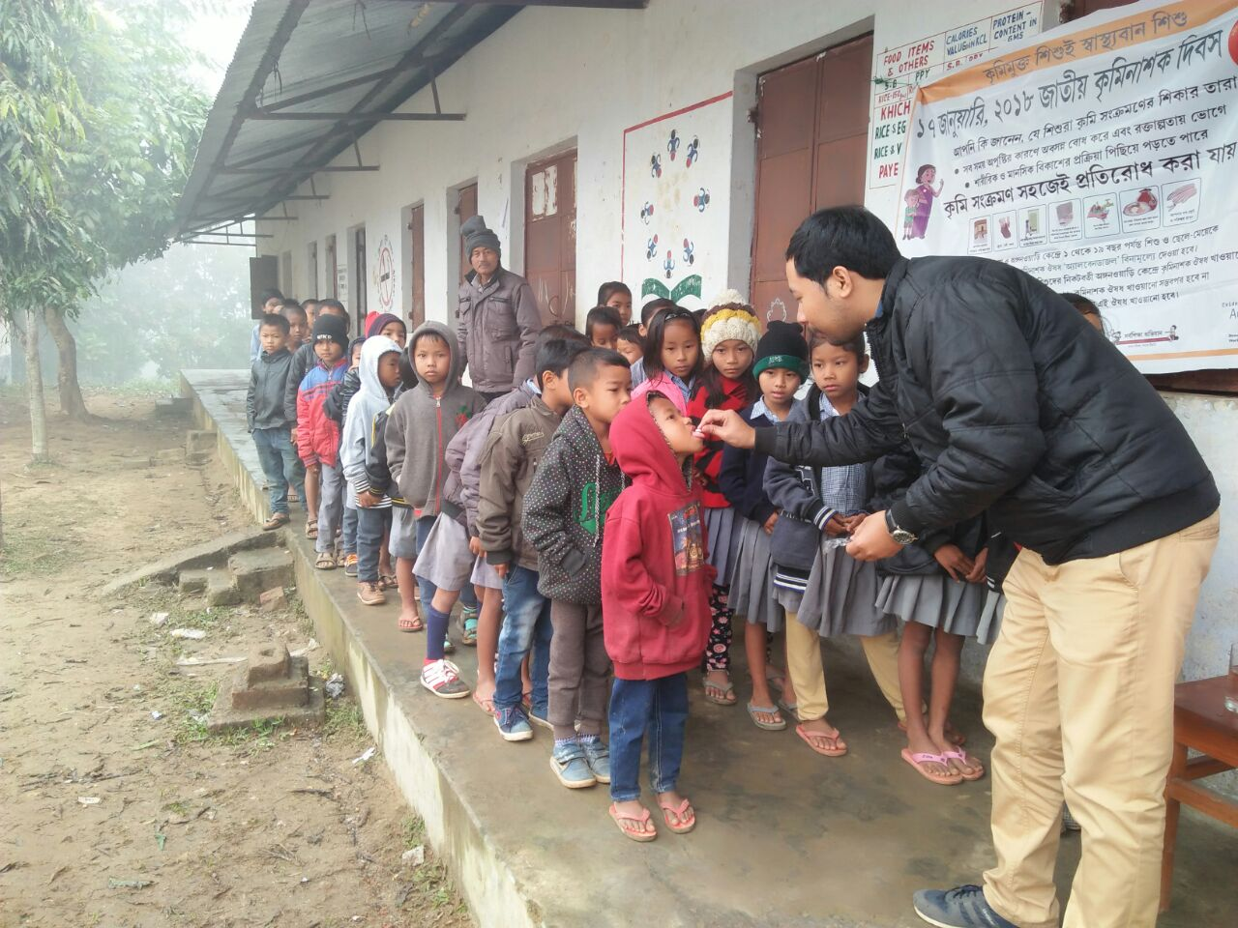
School Health Programe
Garian Tilla J.B school
Sepahijala District
Acharya Praffulya Chandra H.S School, West Tripura District

Slide 54
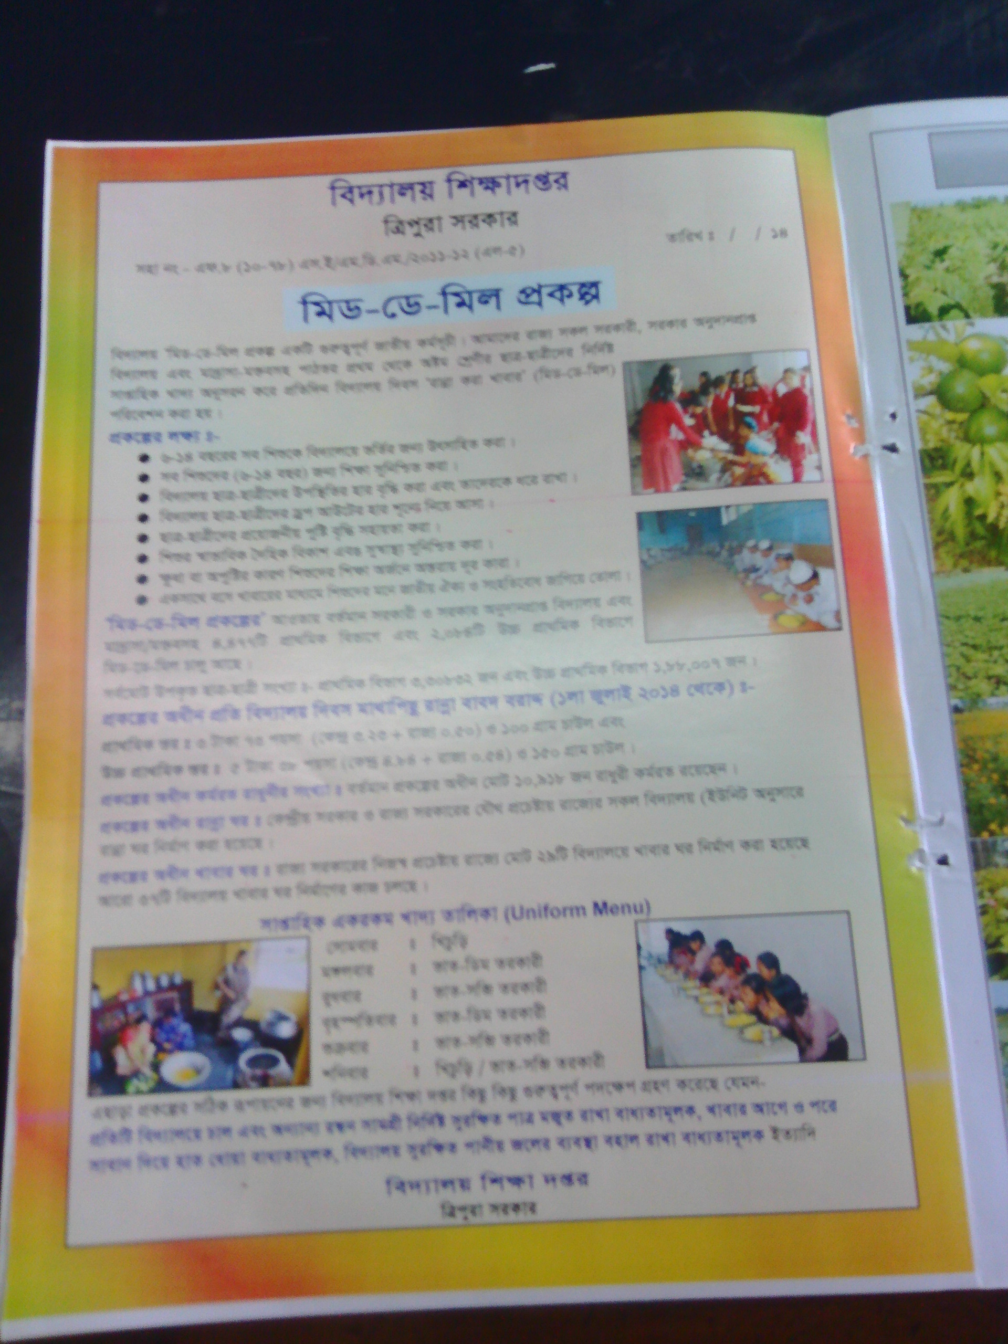
Publication in Local Magazine

Slide 55
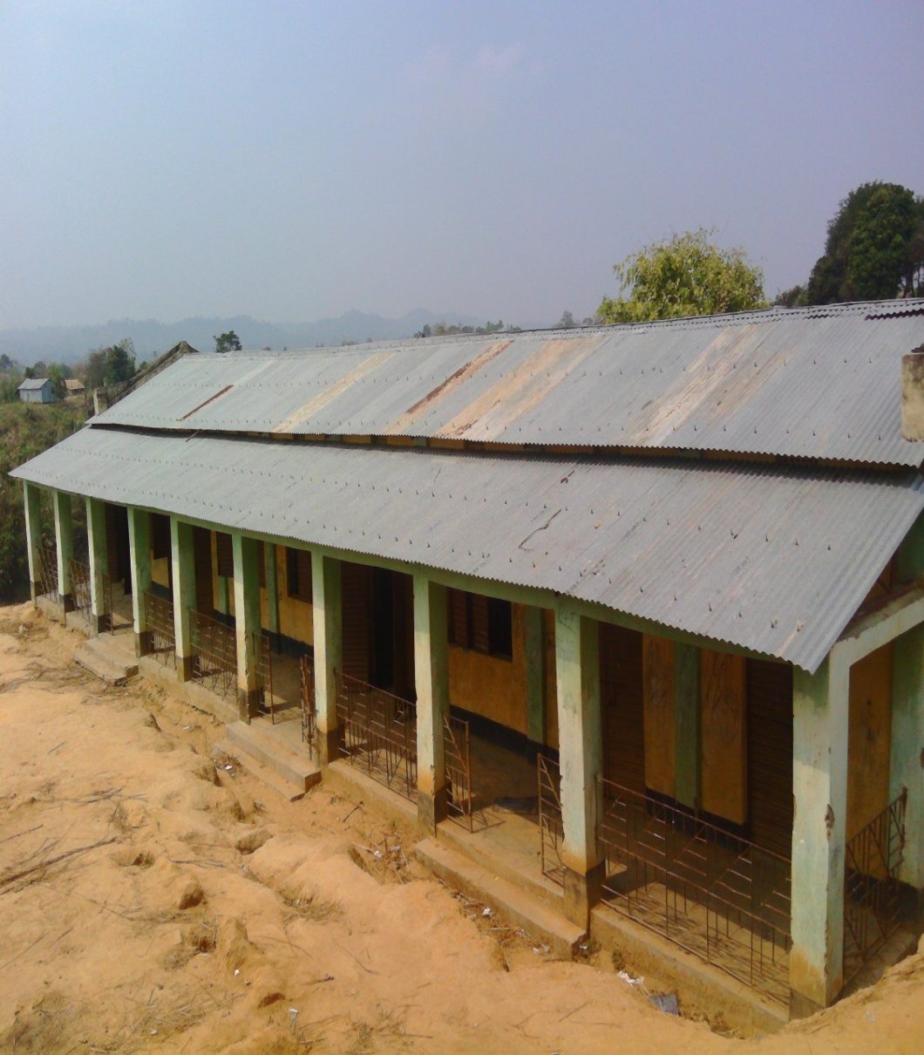
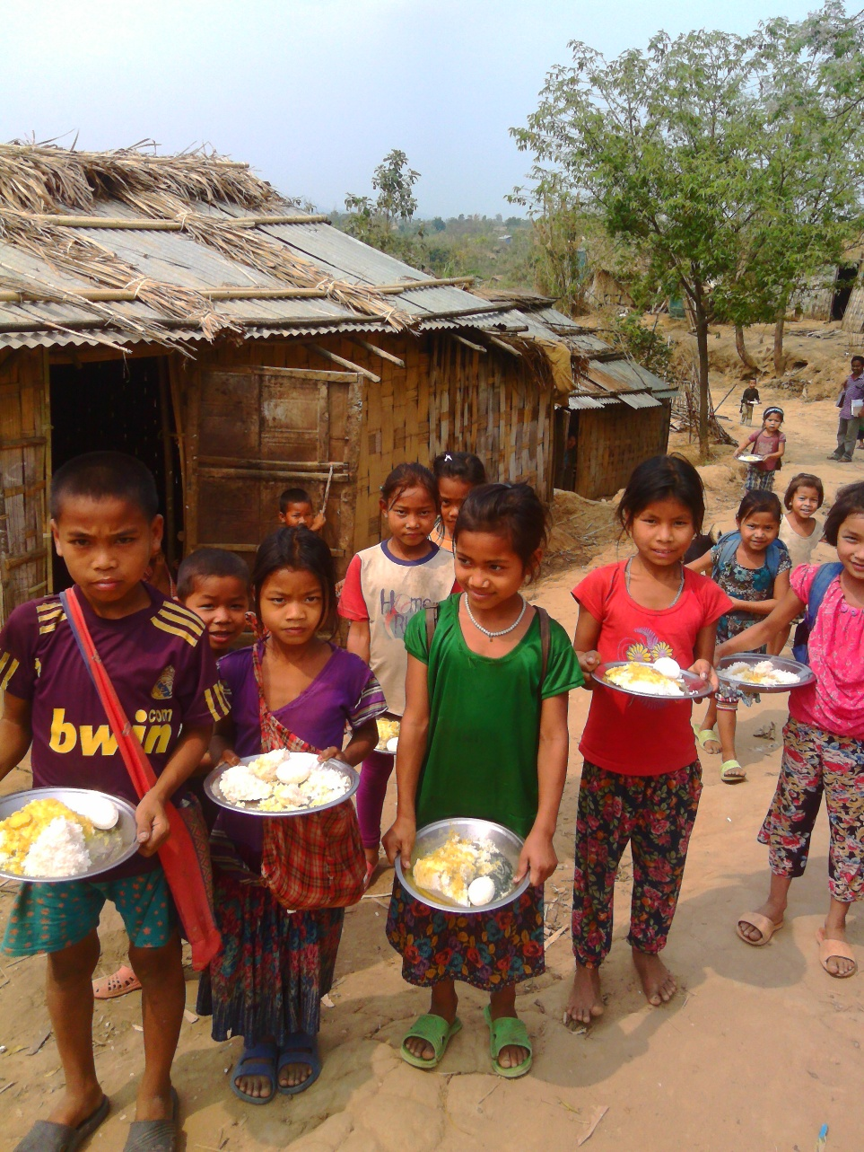
NRSTC Building & Children

Slide 56
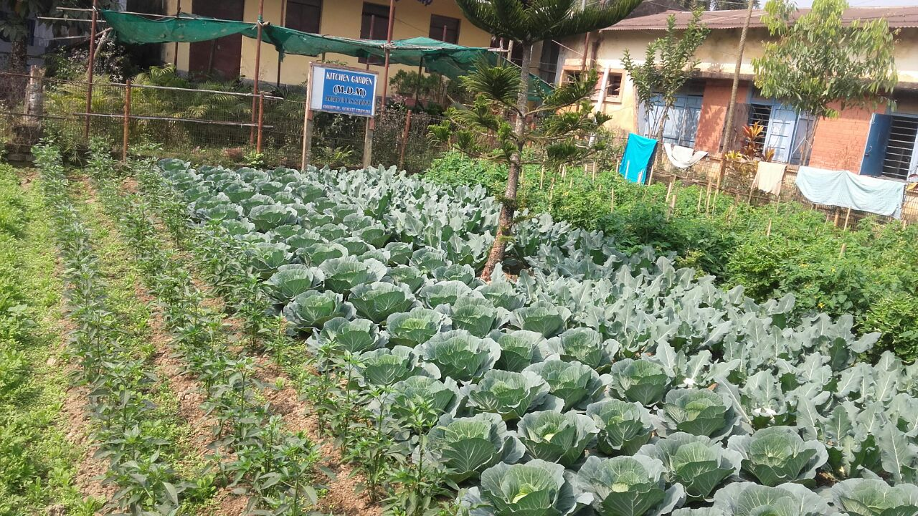
KITCHEN GARDEN
Garur Bandh High School
Sepahijala District

Slide 57
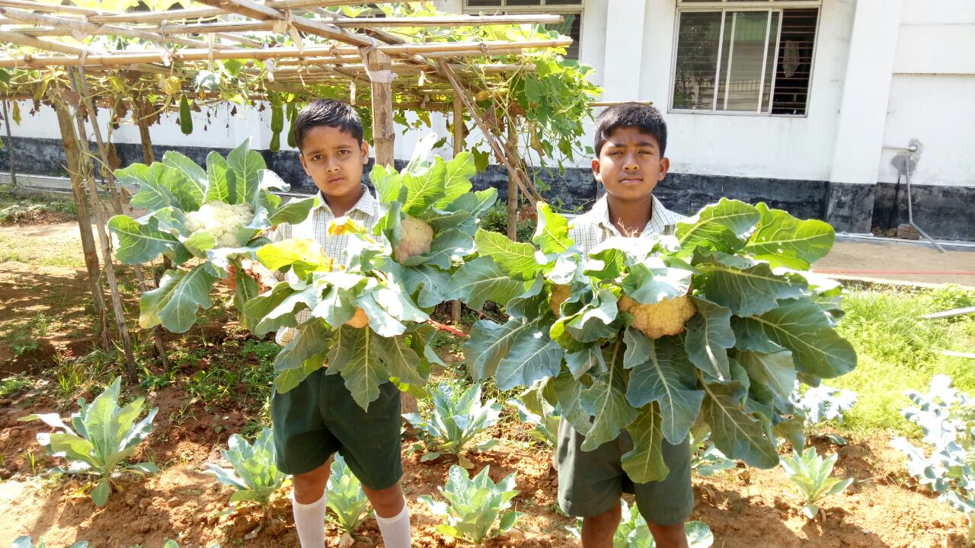
KITCHEN GARDEN
Acharya Praffulya Chandra H.S School, West Tripura District

Slide 58
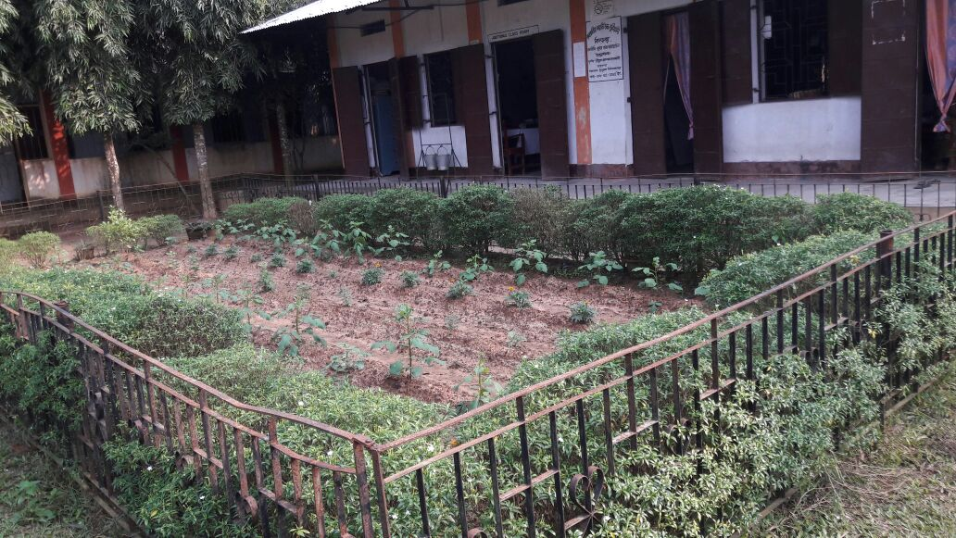
KITCHEN GARDEN
Bisramganj H.S School
Sepahijala District

Slide 59
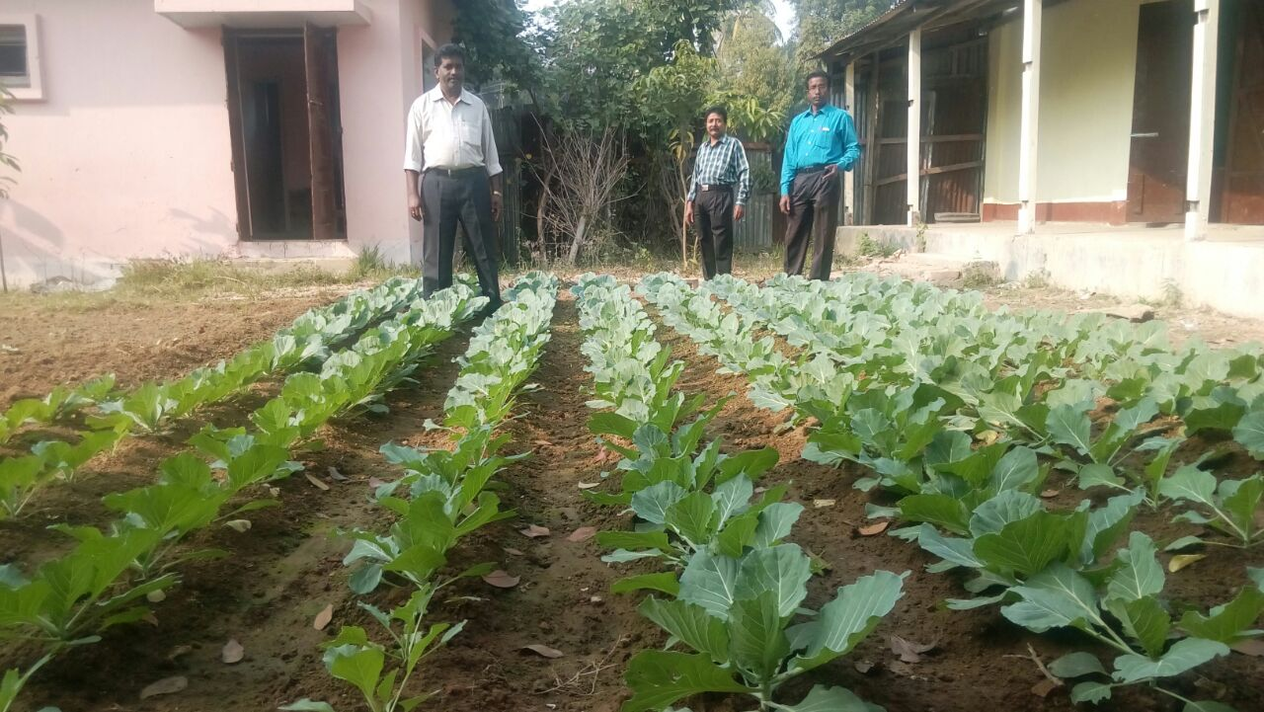
KITCHEN GARDEN
Chandra Para J.B School
Killa Block, Gomati District

Slide 60
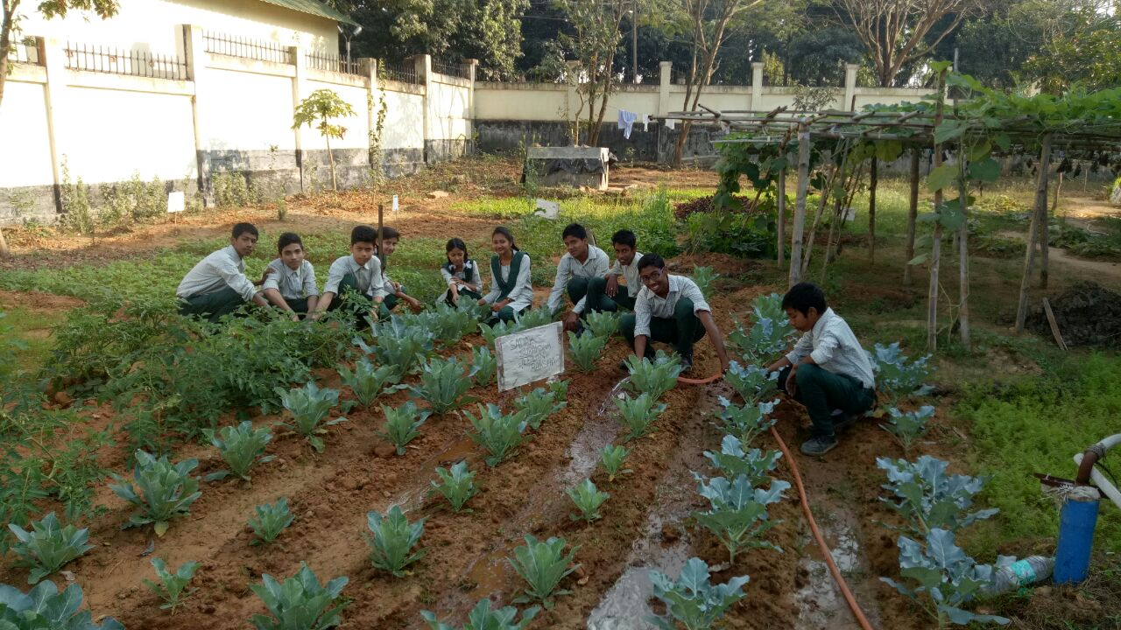
KITCHEN GARDEN
Acharya Praffulya Chandra H.S School, West Tripura District

Slide 61
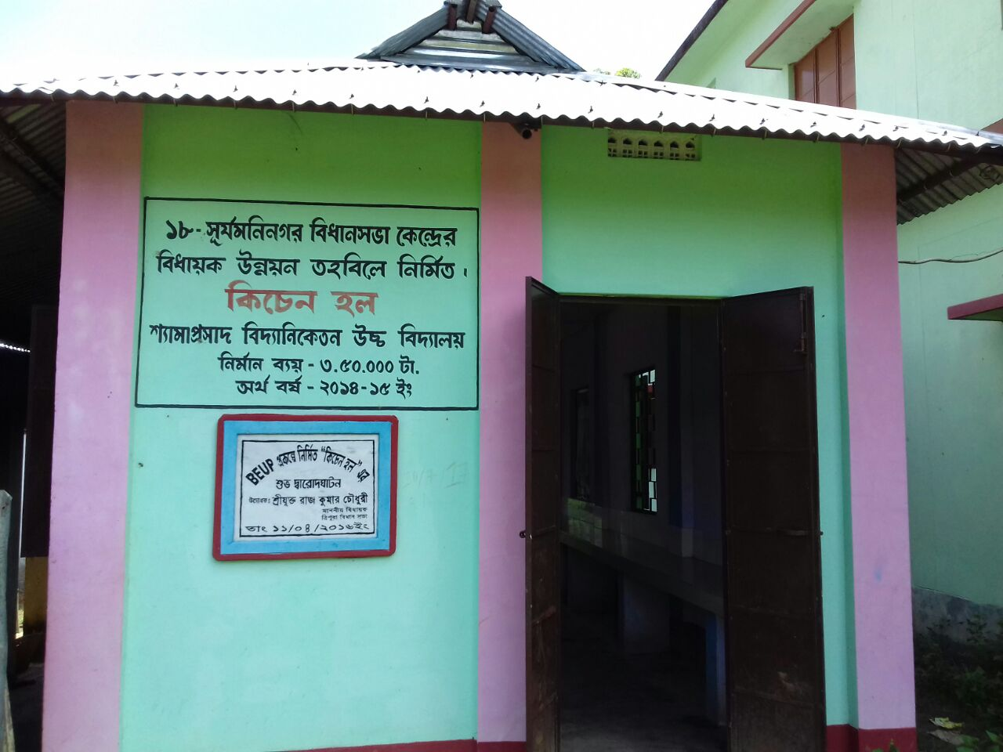
Kitchen shed constructed in Shyama
Prasad High School from MLA fund

Slide 62
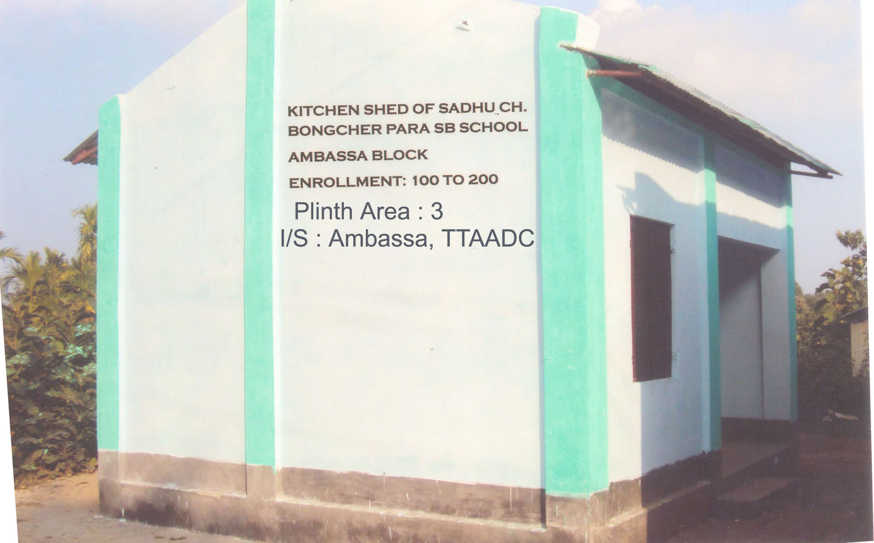

Slide 63
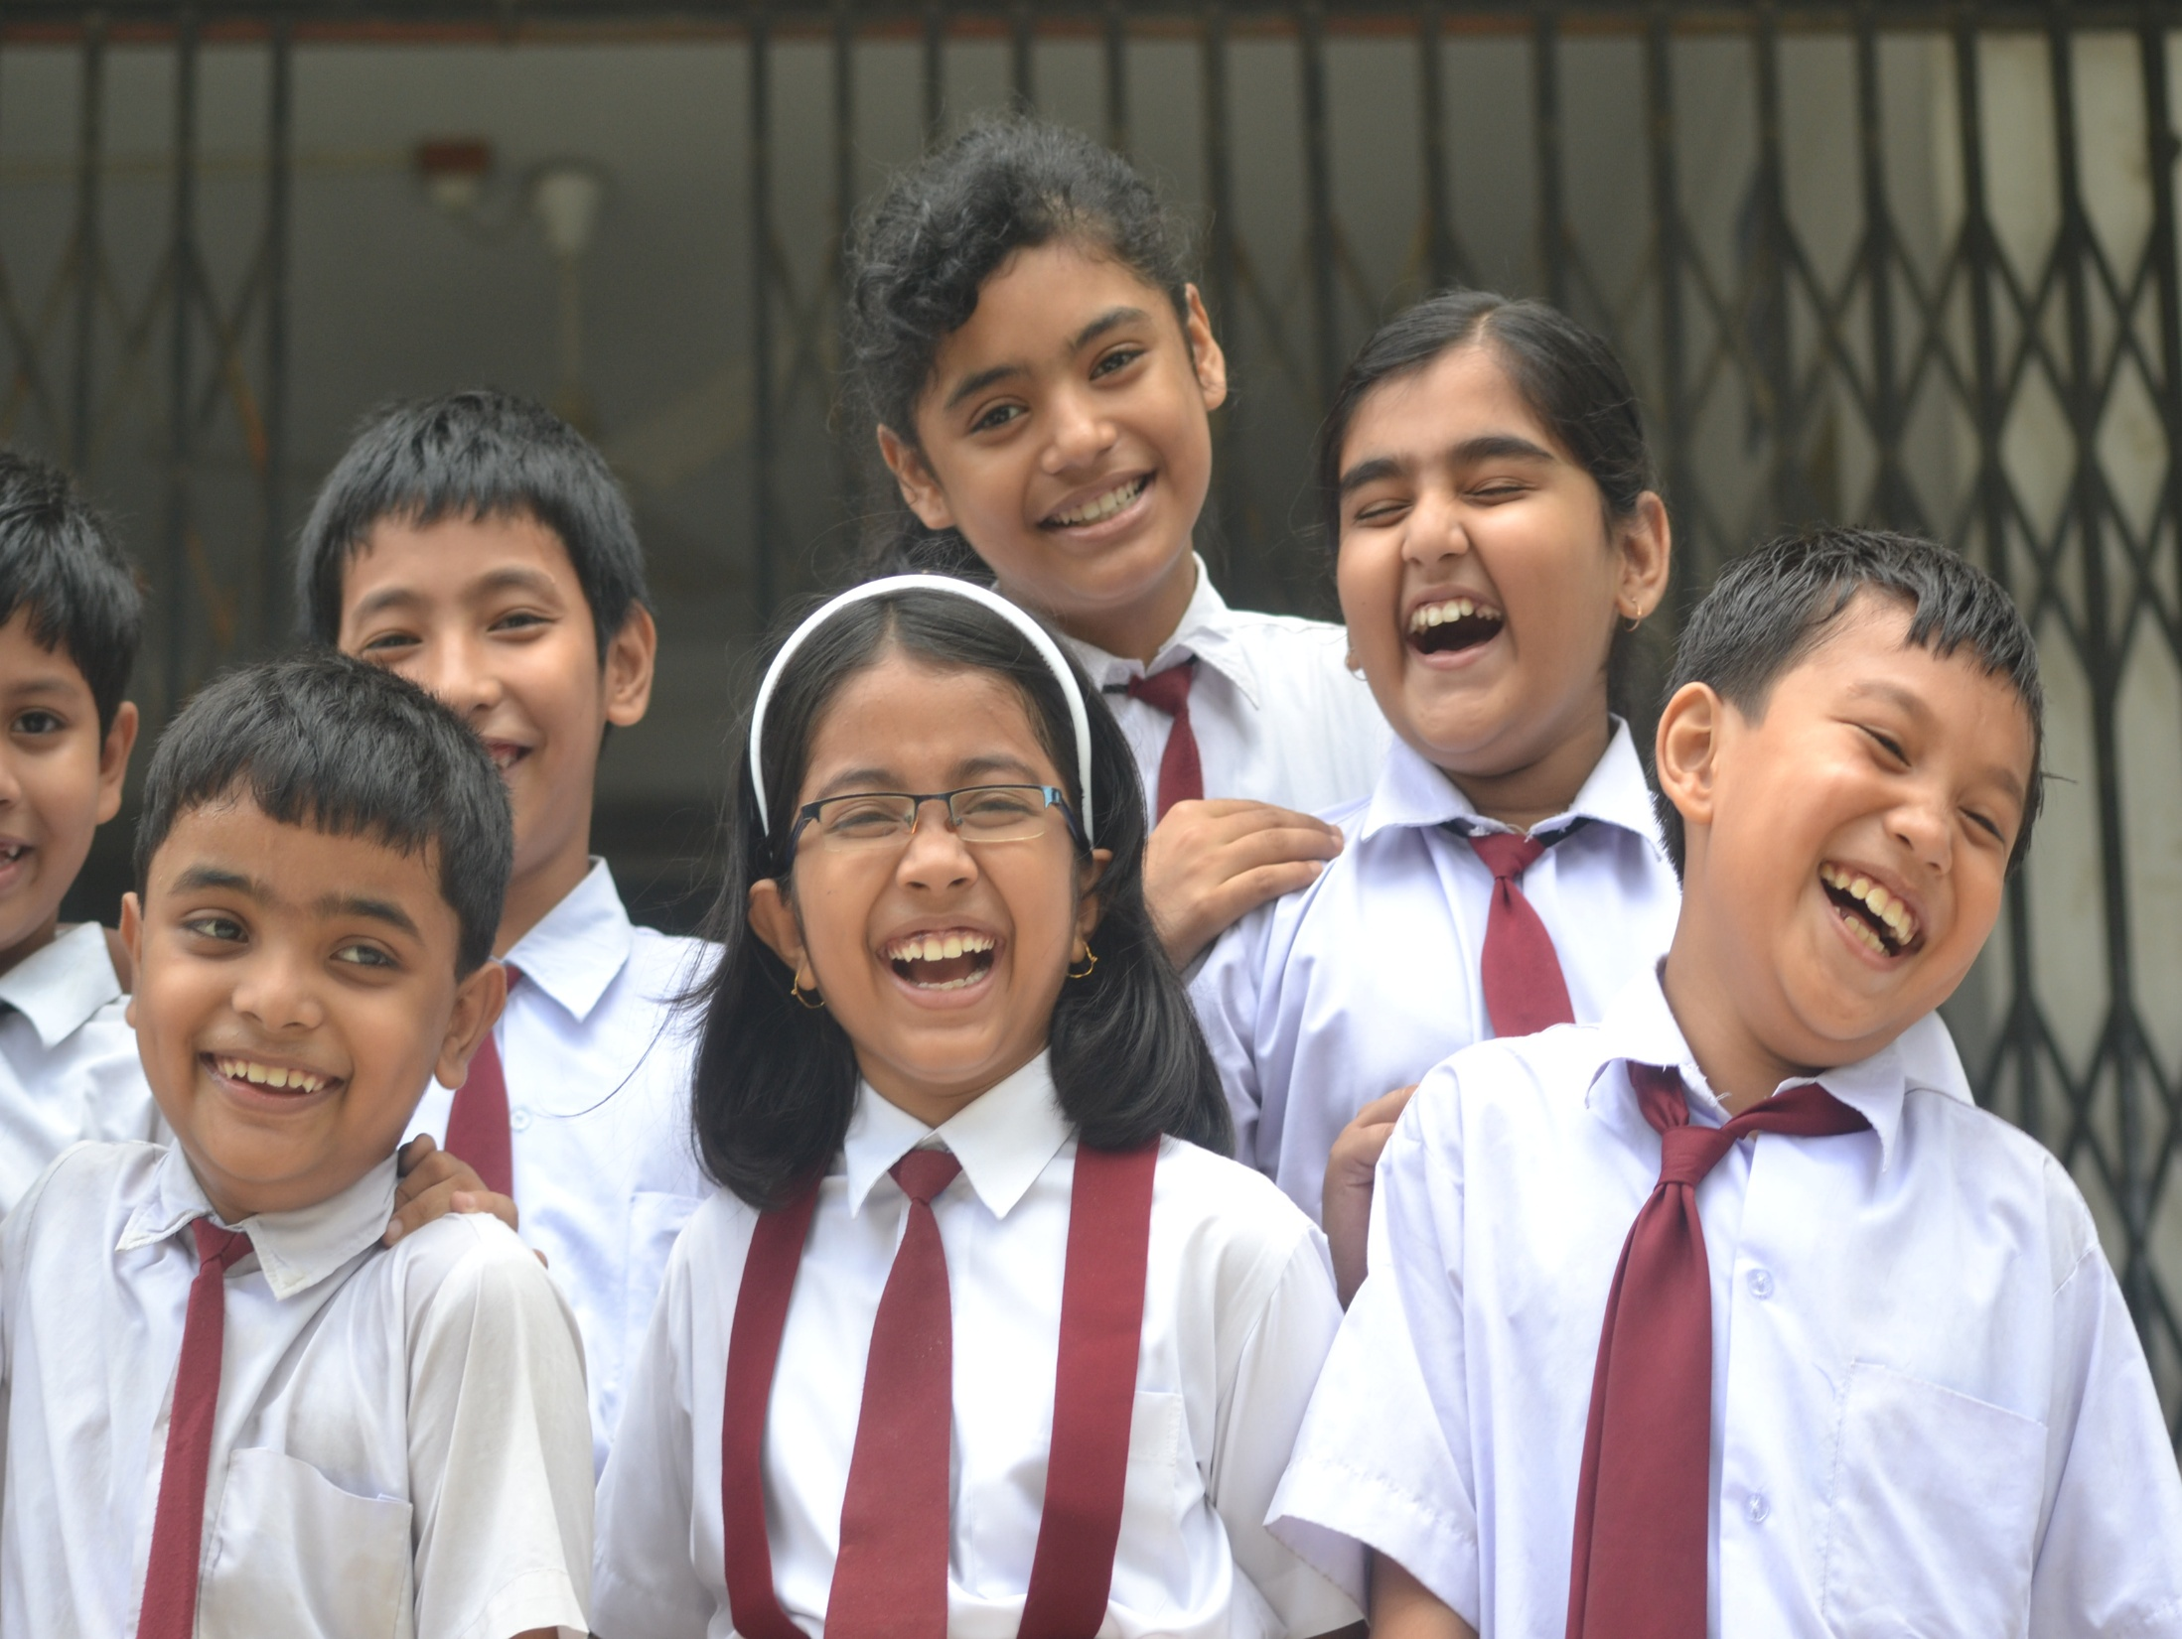
THANK YOU

